Slide 1

Learning and estimating whole sky radiance distributions from a commercial camera
Joseph Del Rocco
Joseph T. Kider Jr.
Charles Brandon Patterson
Hassen Dhrif
•
•
•
•
University of Central Florida
University of Central Florida
Full Sail University
University of Miami

Slide 2
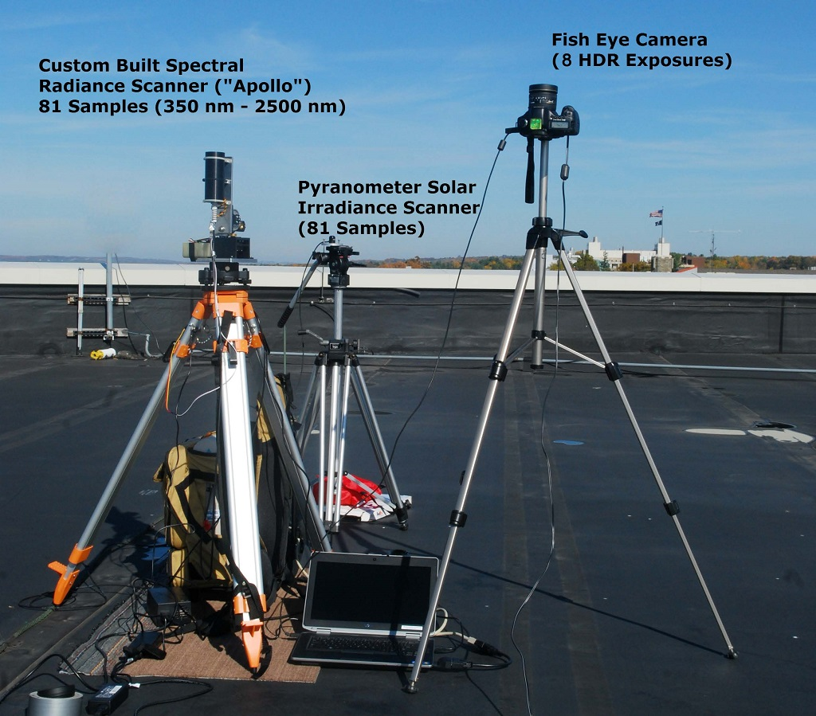
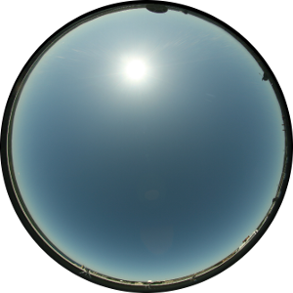
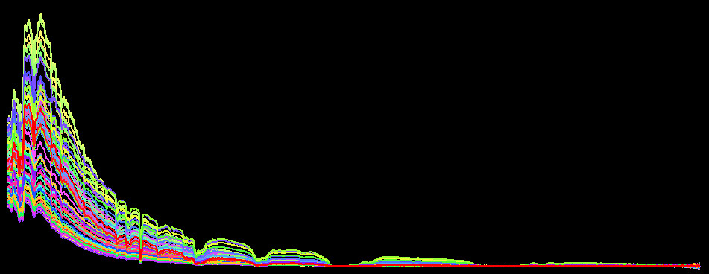
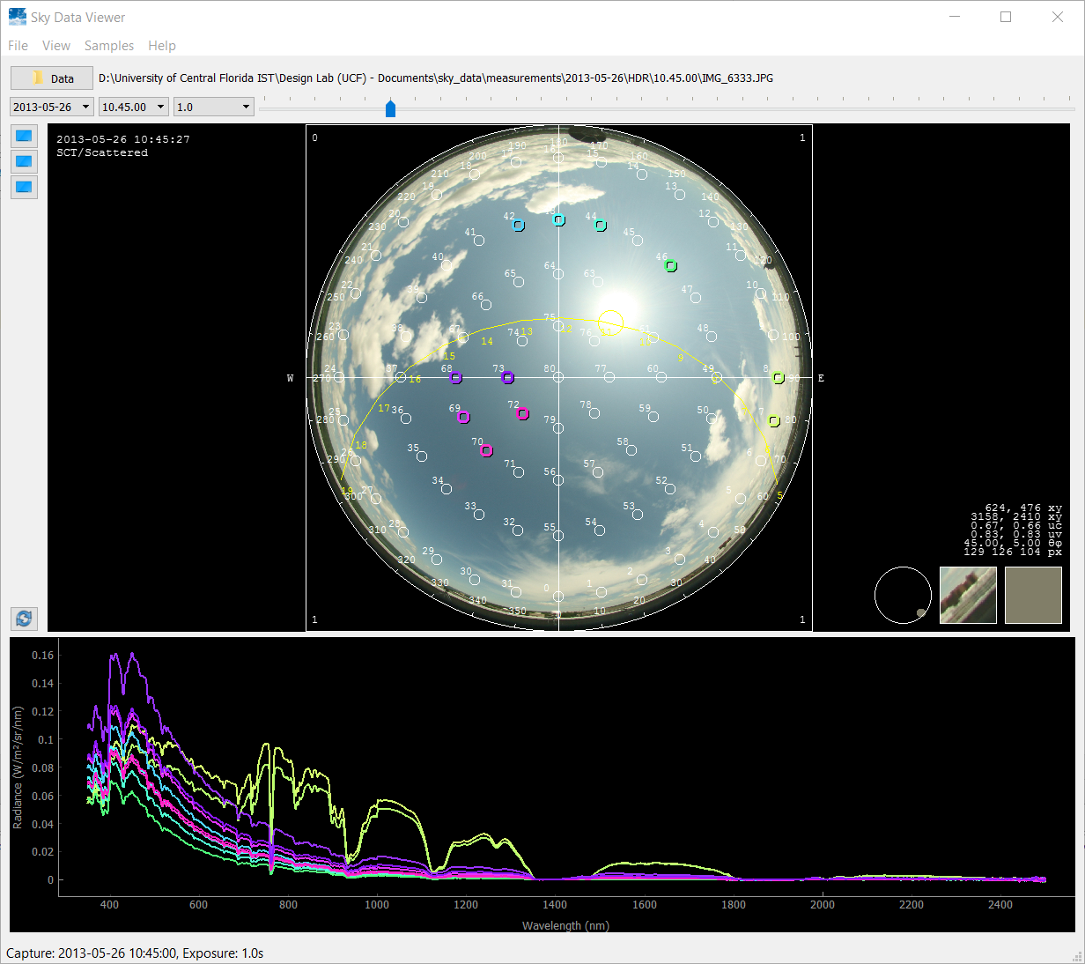
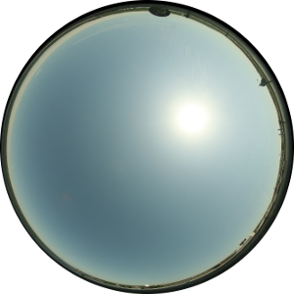
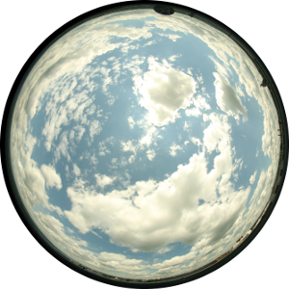
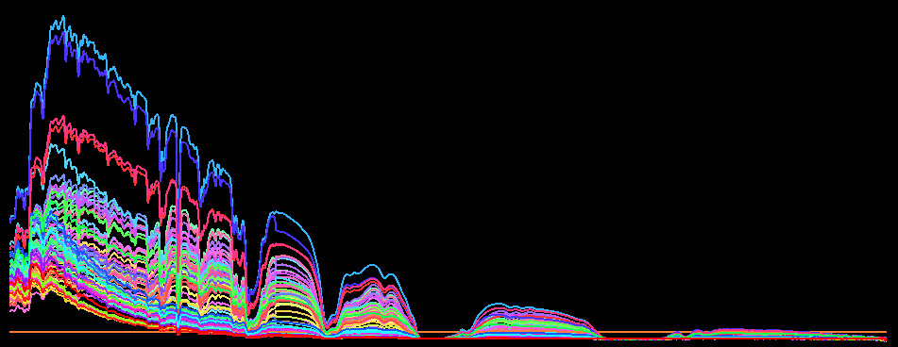
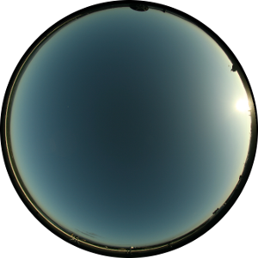
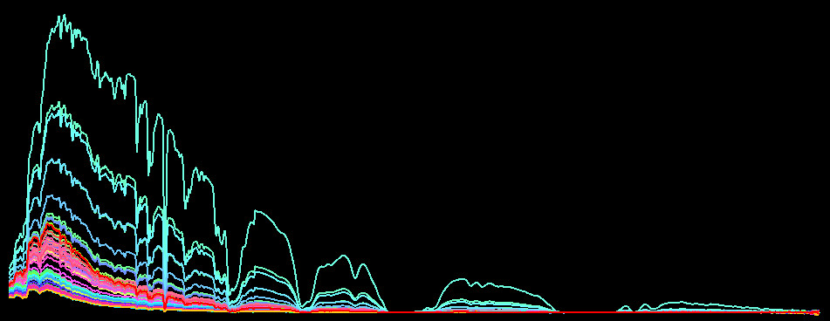
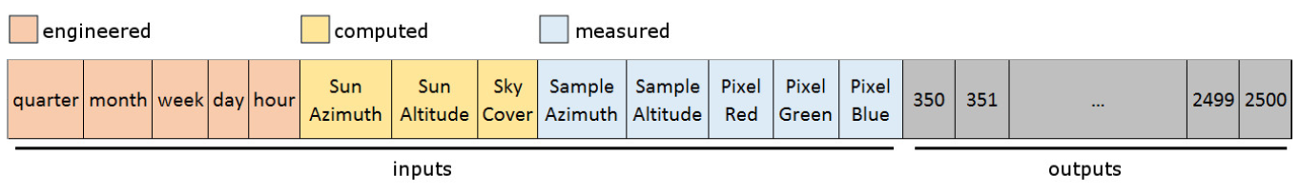
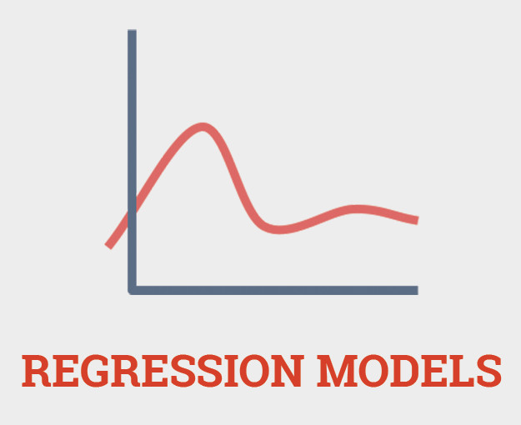
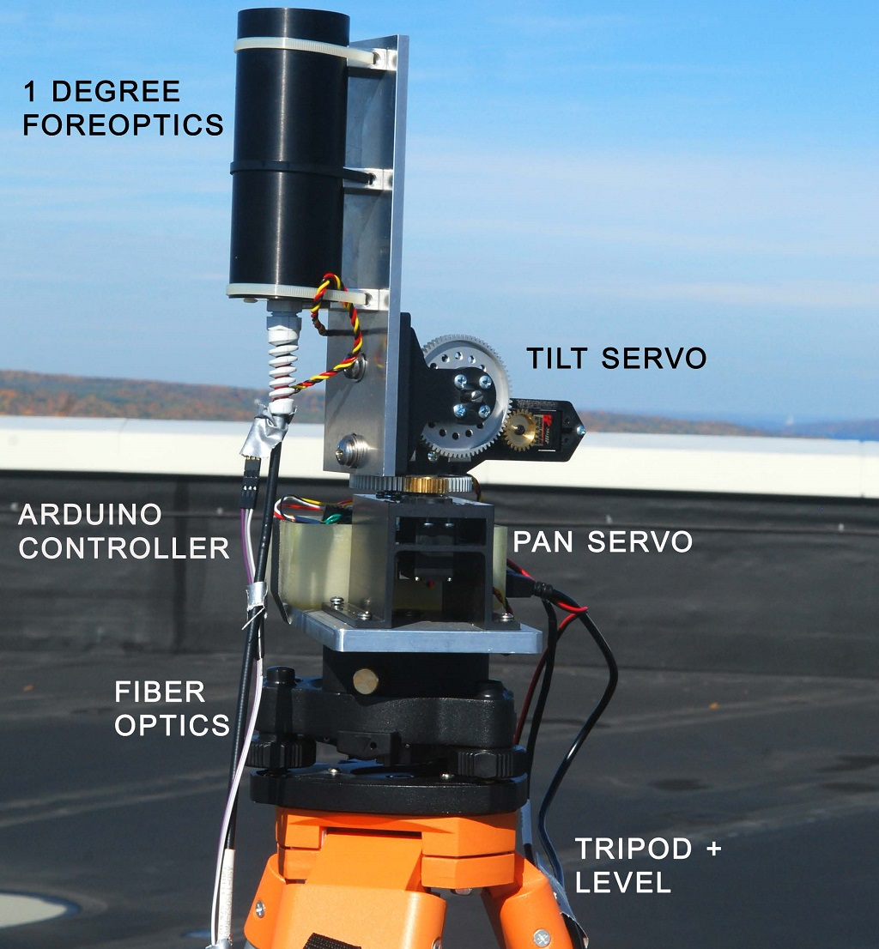
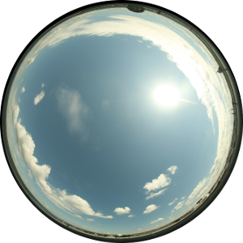
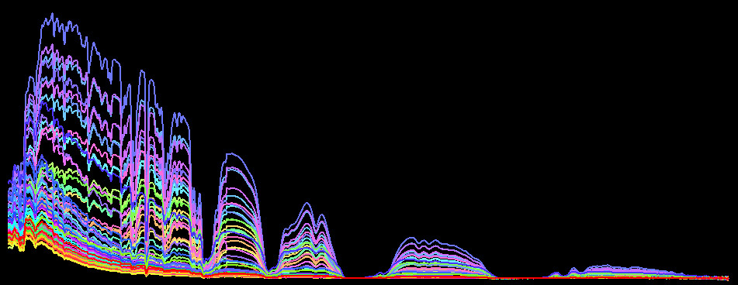

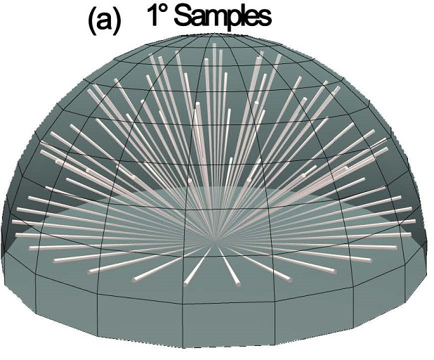
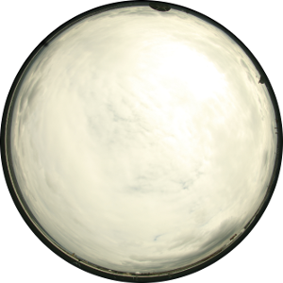
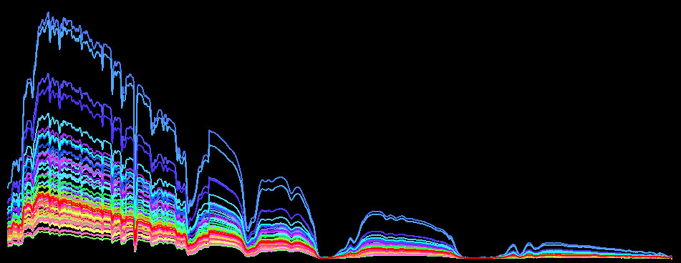
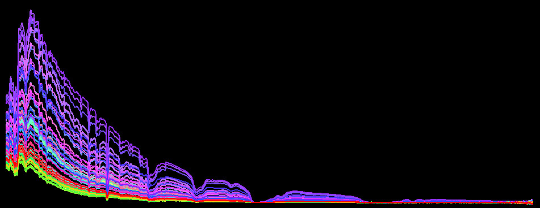
The 30,000m view
data capture
data cleanup + model training
prediction
ML code
Notes:
The big picture overview

Slide 3
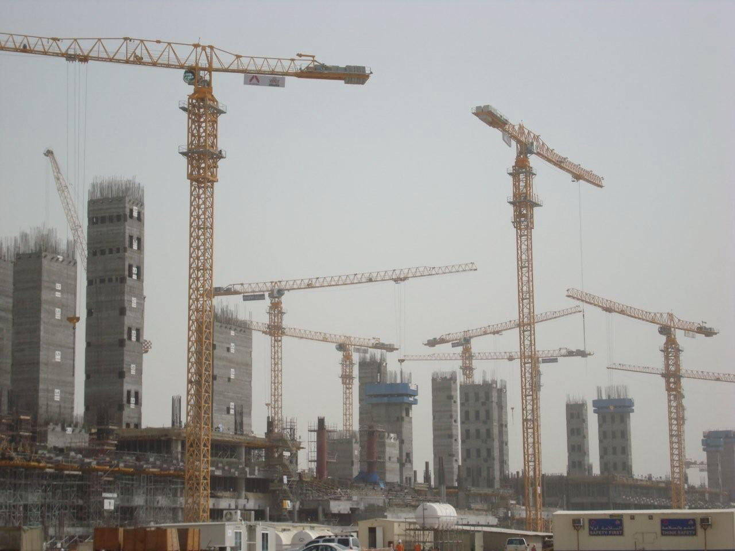
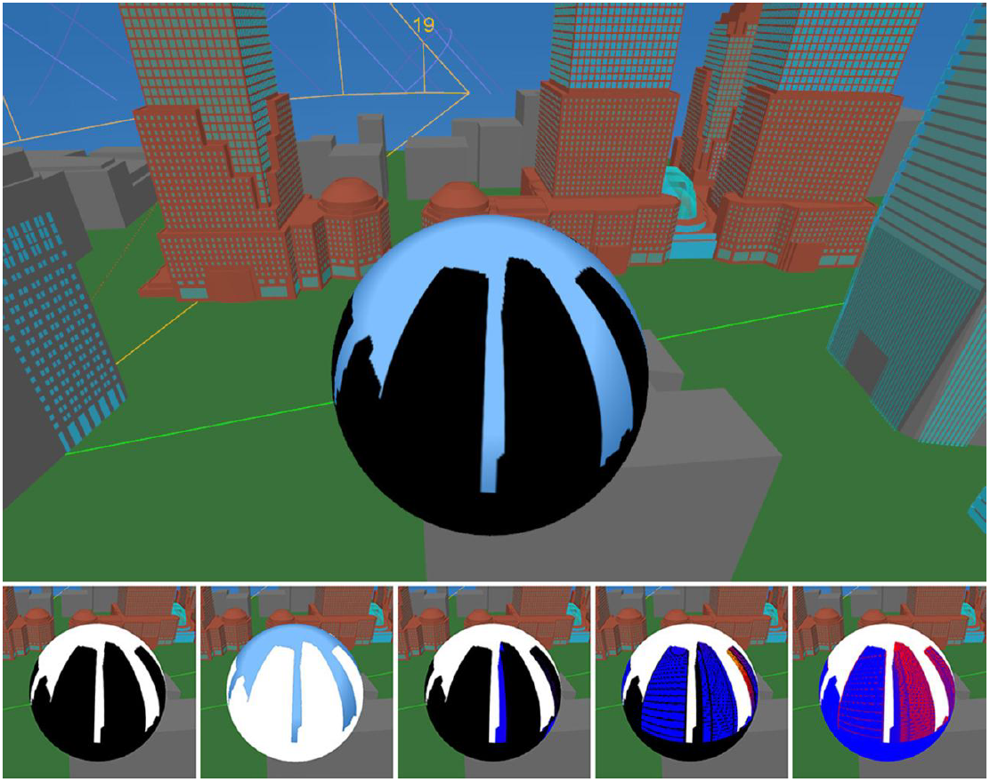
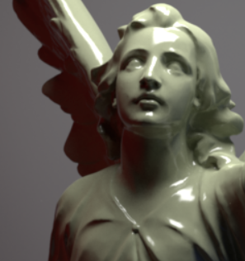
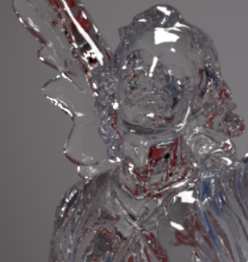
Motivation
Schumann, L., & Greenberg, D. P.
Building performance
Buildings consume 47% US energy (72% w/ mfg)
Simulations (BEFORE construction)
Many buildings coming in India and China
Spectral radiance for radiative transfer
Whole sky
Not just zenith down-welling radiance
Occlusion
Light transport, PBRT
Wavelength dependent scattering, absorption
mitsuba-renderer.org
Notes:
Use of spectral radiance

Slide 4
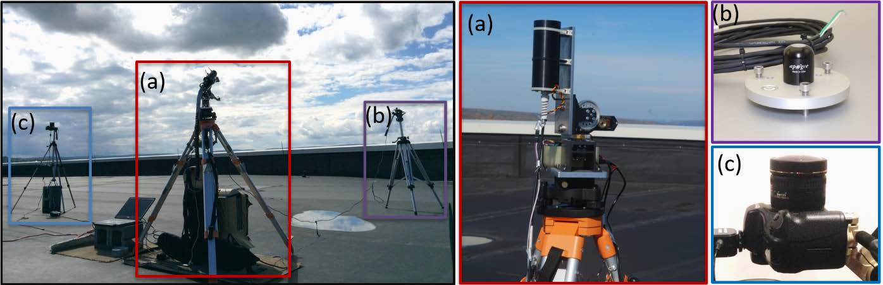
Data capture
Kider Jr, J. T., Knowlton, D., Newlin, J., Li, Y. K., and Greenberg, D. P., “A framework for the experimental comparison of solar and skydome illumination,” ACM Transactions on Graphics (TOG) 33(6), 180 (2014)
ASD FieldSpec Pro spectroradiometer (350nm – 2500nm)
Apogee pyranometer
Canon 5D w/ Sigma 8mm circular fish-eye lens
4368 x 2912
CR2 and JPG
Arduino w/ Java
Compass
Notes:
(commercial camera)

Slide 5
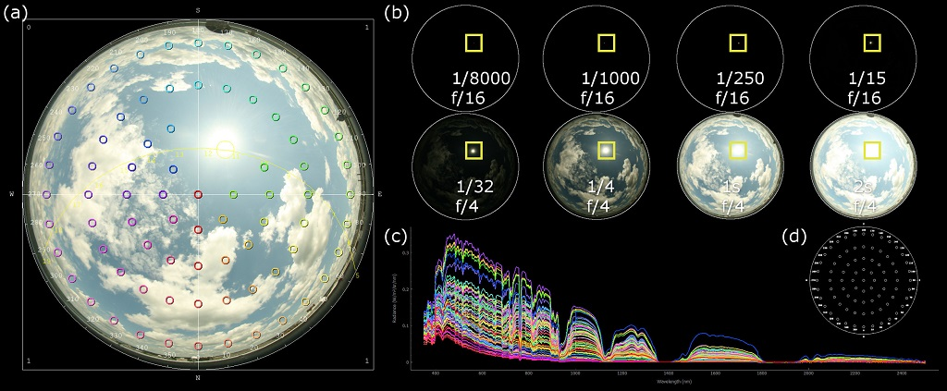
Data capture
(11/06/2012 – 09/26/2013) 453 captures (used)
36693 samples total (453 x 81)
22996 in final exported dataset w/ 20° circumsolar avoidance
Initially exported: timestamp, RGB (single pixel) and radiance
Notes:
(commercial camera)

Slide 6
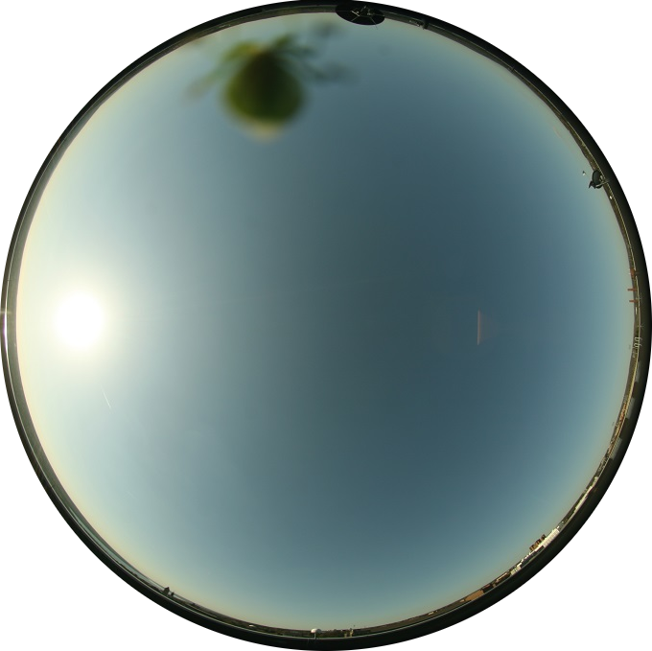
Data capture in the wild is prone to bugs…

Slide 7

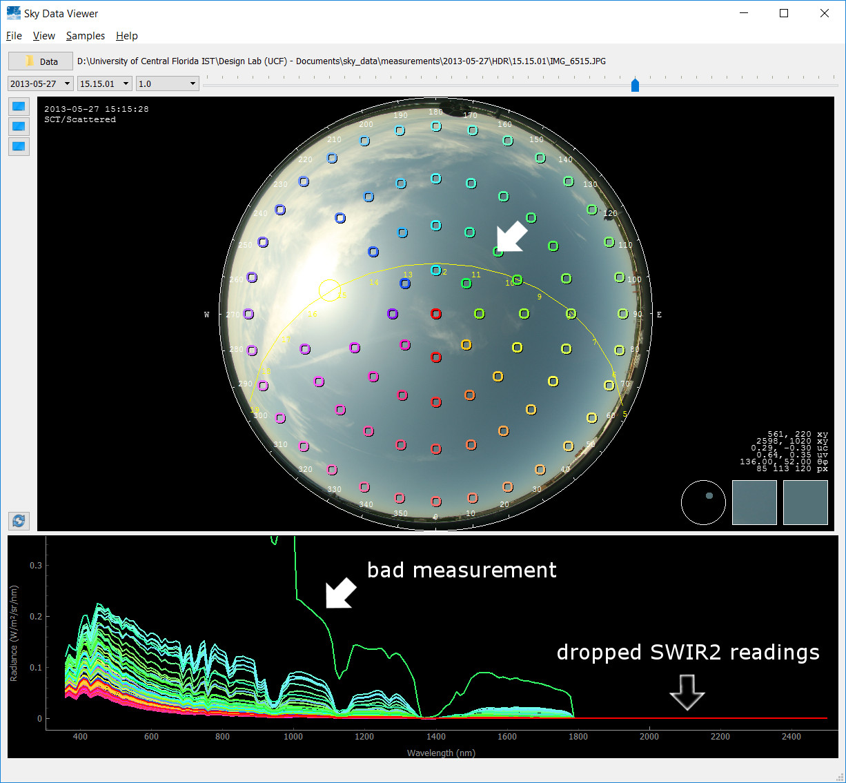
SkyDataViewer

Slide 8
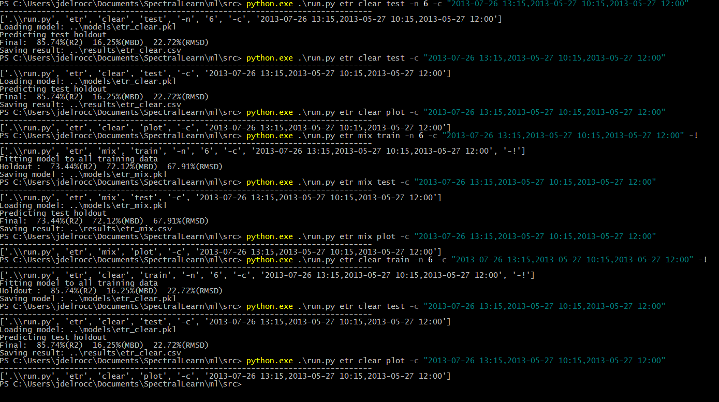
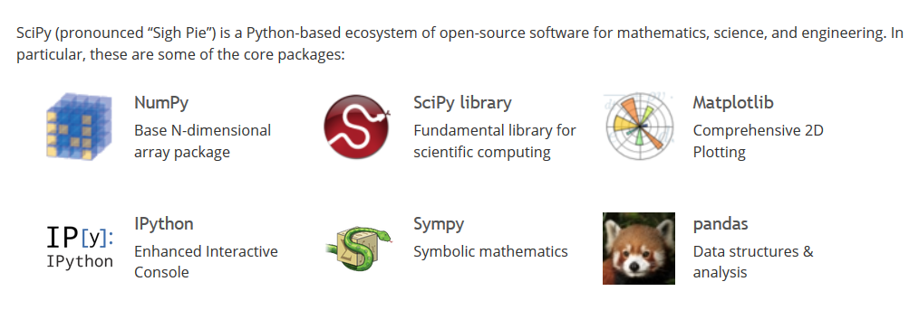
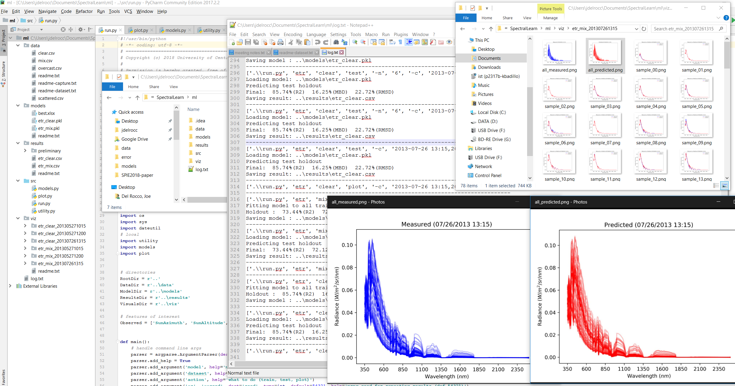
Machine Learning framework
Python + scikit-learn (+ SciPy)
PyQt5 for SkyDataViewer
Notes:
deep-learning frameworks, TensorFlow etc.
Weka
scikit-learn

Slide 9


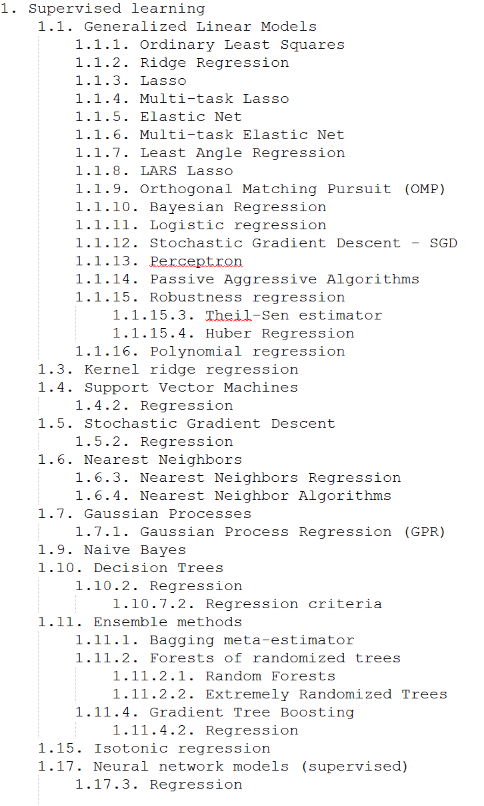
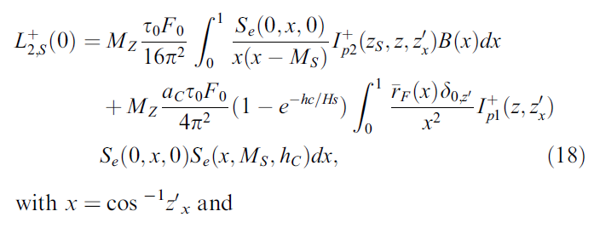
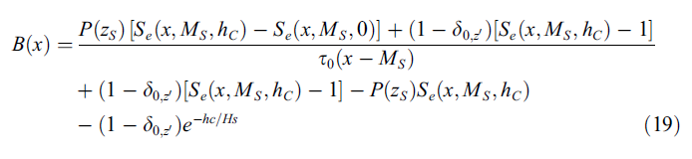
Machine learning – OVERLOAD!
ML – a cripplingly heavy toolbox!
Many algorithms / approaches per type of problem
Many parameters and hyperparameters per algorithm
Many error metrics to choose from (your own perhaps)
NO SILVER BULLETS!
Lots of SMEs/PhDs out there right now:
John Langford, Andrew Ng, Yangqing Jia, Christopher Olah, Samy Bengio, Tom Mitchell, Michael Auli, Scott Fortmann-Roe, Jason Brownlee, Jim Frost...
Great avenue for a real-time estimation, vs. say…
Kocifaj, M. (2015). Unified model of radiance patterns under arbitrary sky conditions. Solar Energy, 115, 40-51.
Notes:
“the more I read, the less I know”
Very popular right now with companies/researches developing Ais

Slide 10
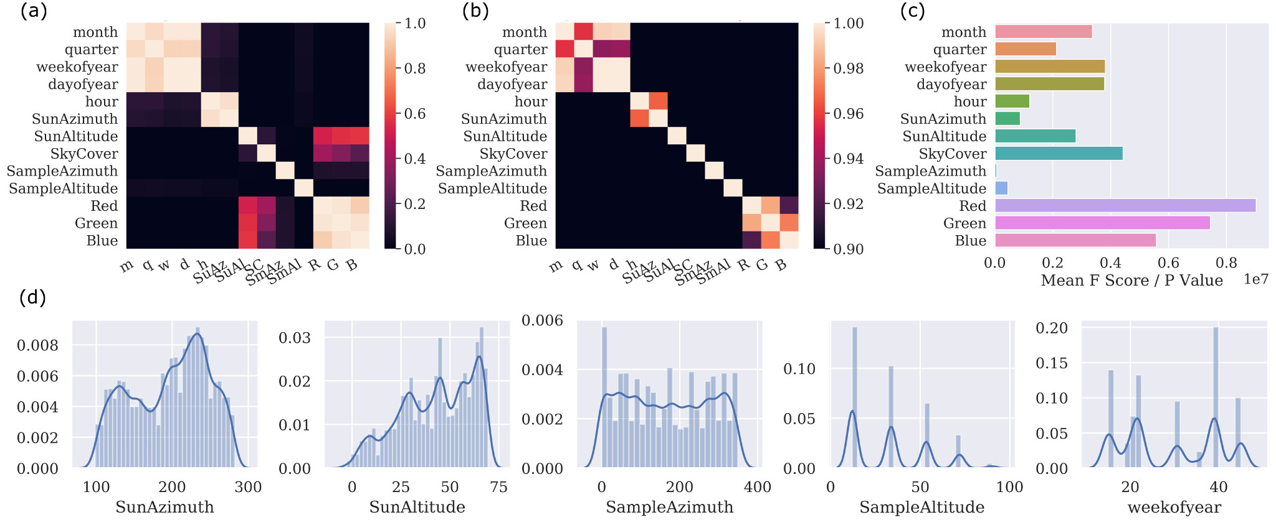
Machine learning – train/test samples
Exploratory Data Analysis
Feature Engineering
“…some machine learning projects succeed and some fail. What makes the difference? Easily the most important factor is the features used.”
- Pedro Domingos, Univ. of Washington

Slide 11
Machine learning – final models
RFR – Random Forest Regressor http://scikit-learn.org/stable/modules/generated/sklearn.ensemble.RandomForestRegressor.html
max depth of tree of 30
ETR – Extra Randomized Trees Regressor http://scikit-learn.org/stable/modules/generated/sklearn.ensemble.ExtraTreesRegressor.html
max depth of tree of 25
number of extra trees 50
KNR – K Nearest Neighbors Regressor http://scikit-learn.org/stable/modules/generated/sklearn.neighbors.KNeighborsRegressor.html
quantile transformer on input features
LNR – Linear Regression http://scikit-learn.org/stable/modules/generated/sklearn.linear_model.LinearRegression.html
polynomial expansion of input features with a degree of 4
quantile transformer on input features

Slide 12
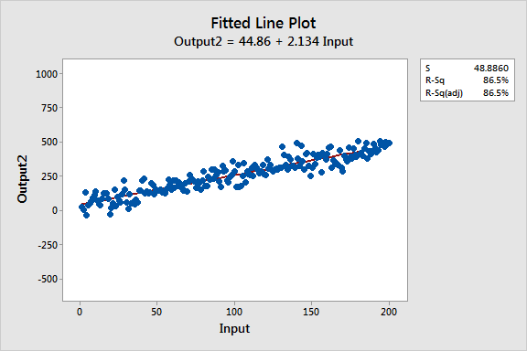
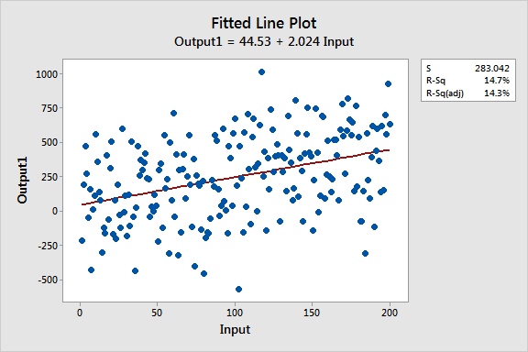
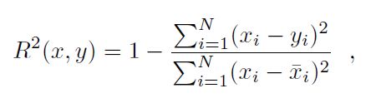
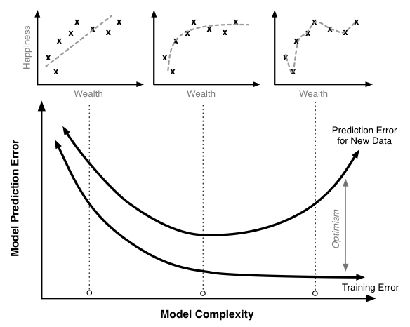
Regression metrics – R²
R² – coefficient of determination score (goodness of fit)
We used R² by default…
But its actually not a good indicator for non-linear http://statisticsbyjim.com/regression/r-squared-invalid-nonlinear-regression
LNR (linear)
RFR, ETR, KNR (non-linear)
scott.fortmann-roe.com
Spiess, Andrej-Nikolai, Natalie Neumeyer. An evaluation of R2 as an inadequate measure for nonlinear models in pharmacological and biochemical research: a Monte Carlo approach. BMC Pharmacology. 2010; 10: 6.
statisticsbyjim.com (Jim Frost)

Slide 13
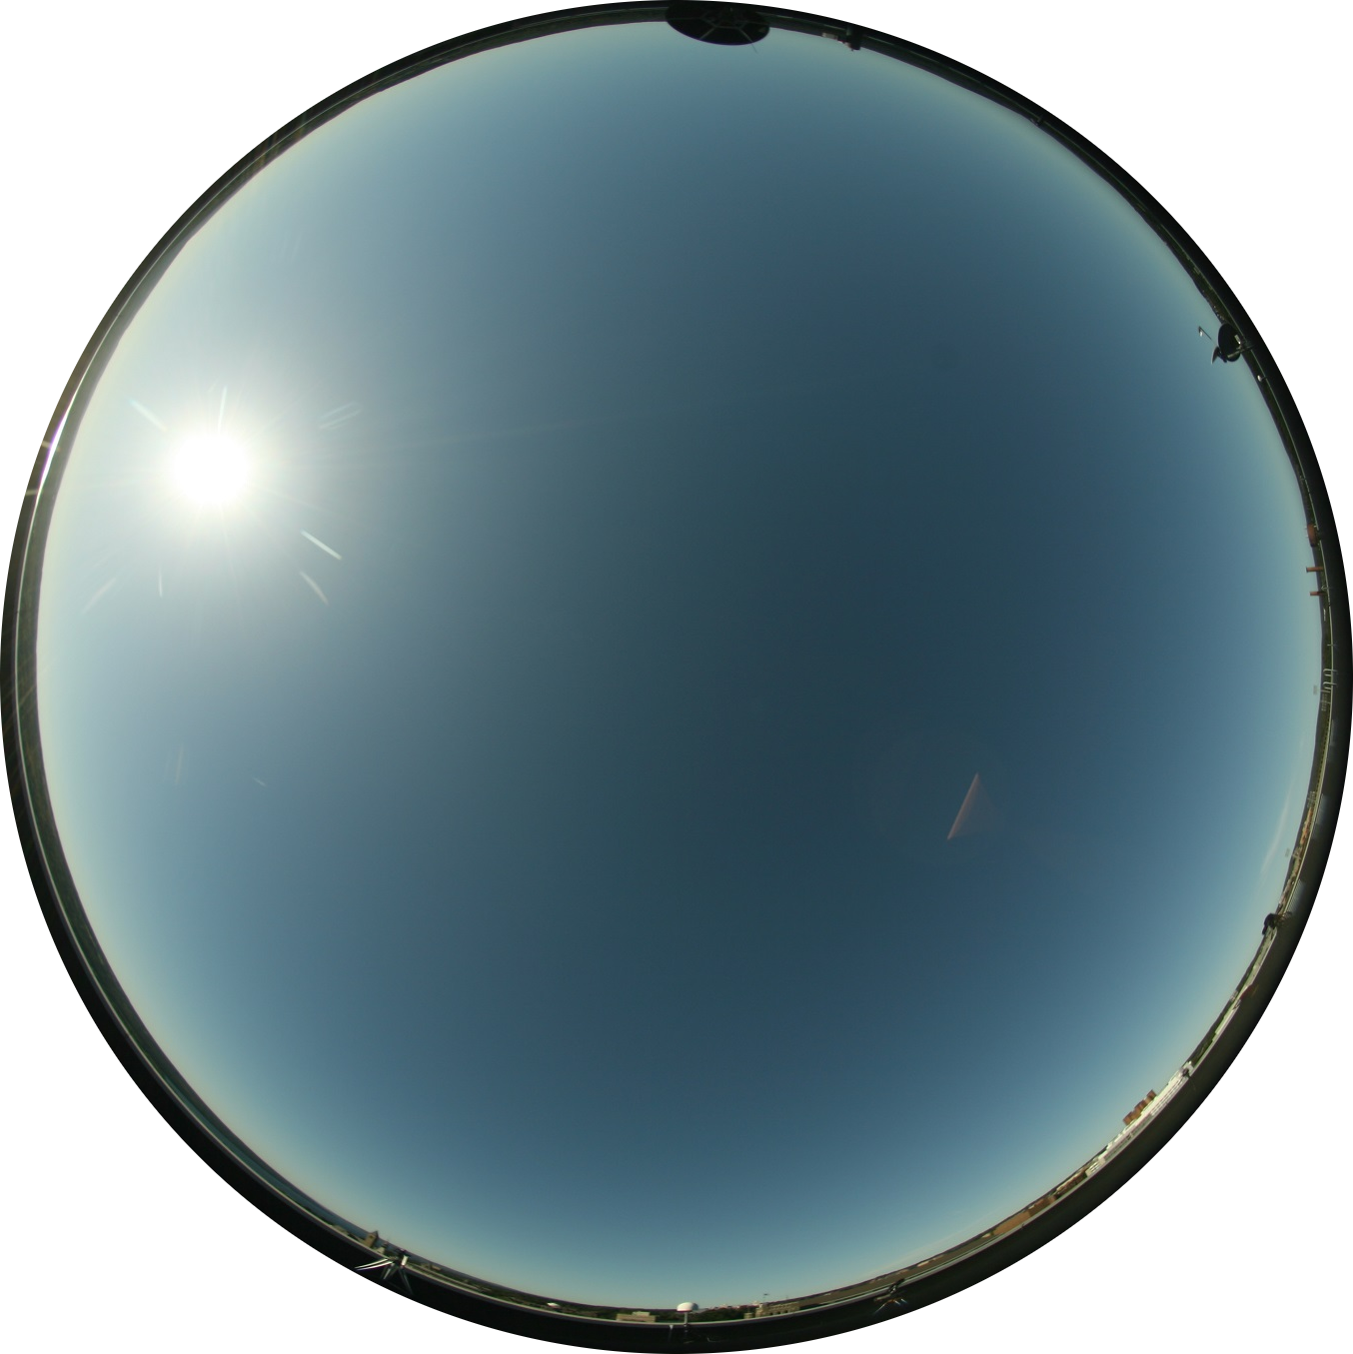
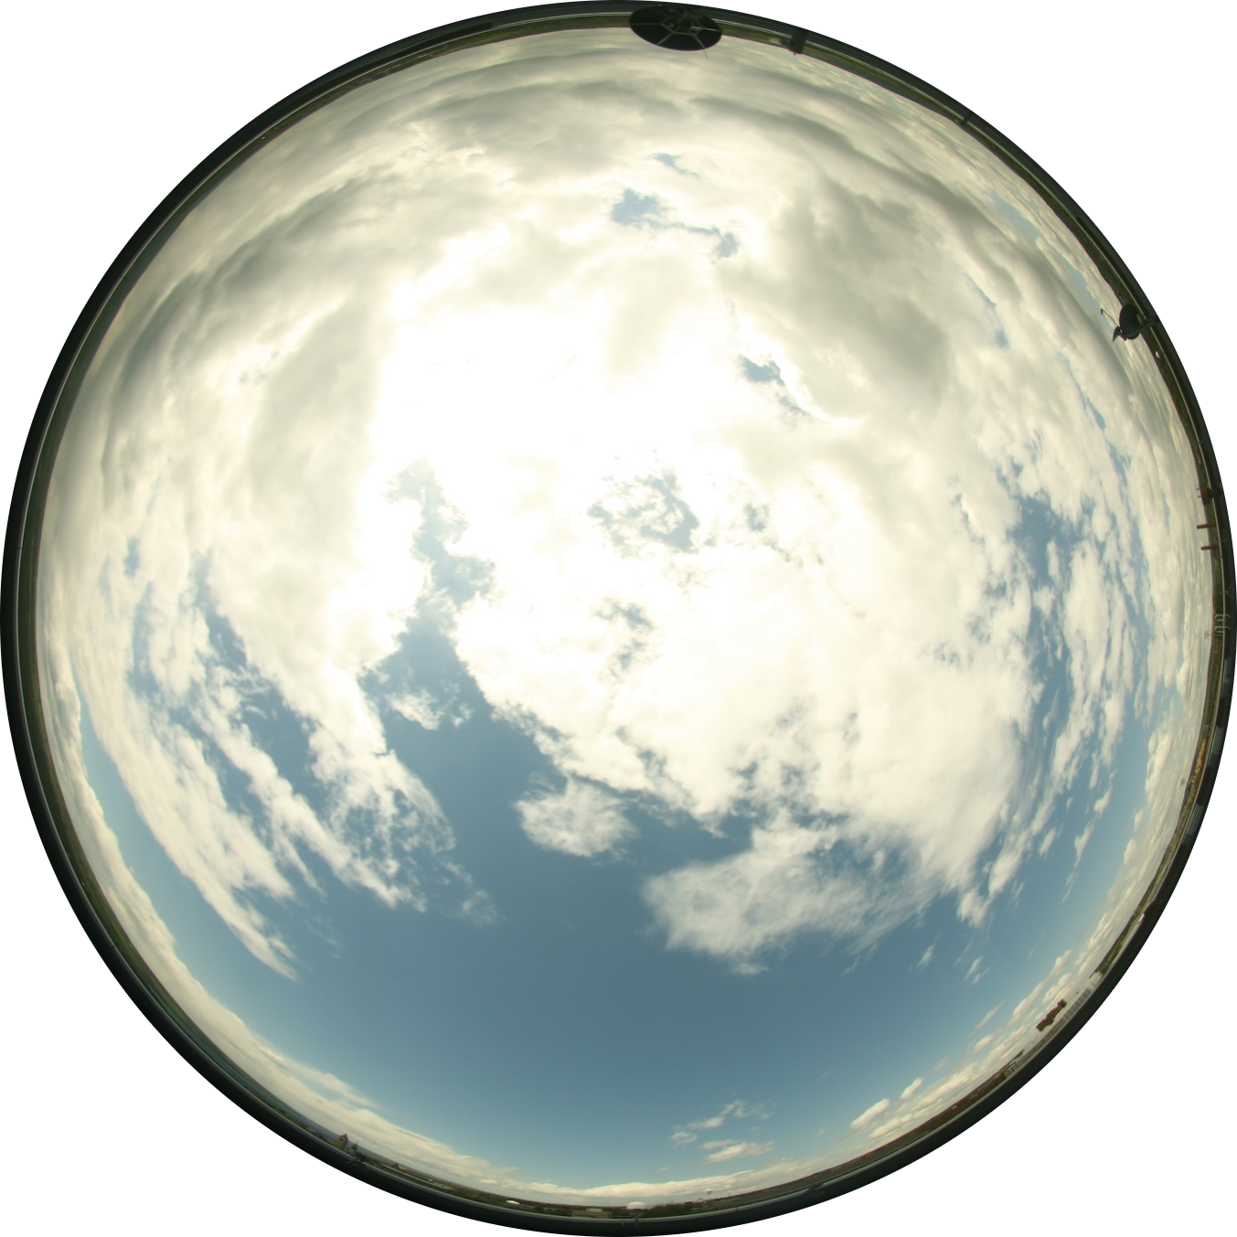
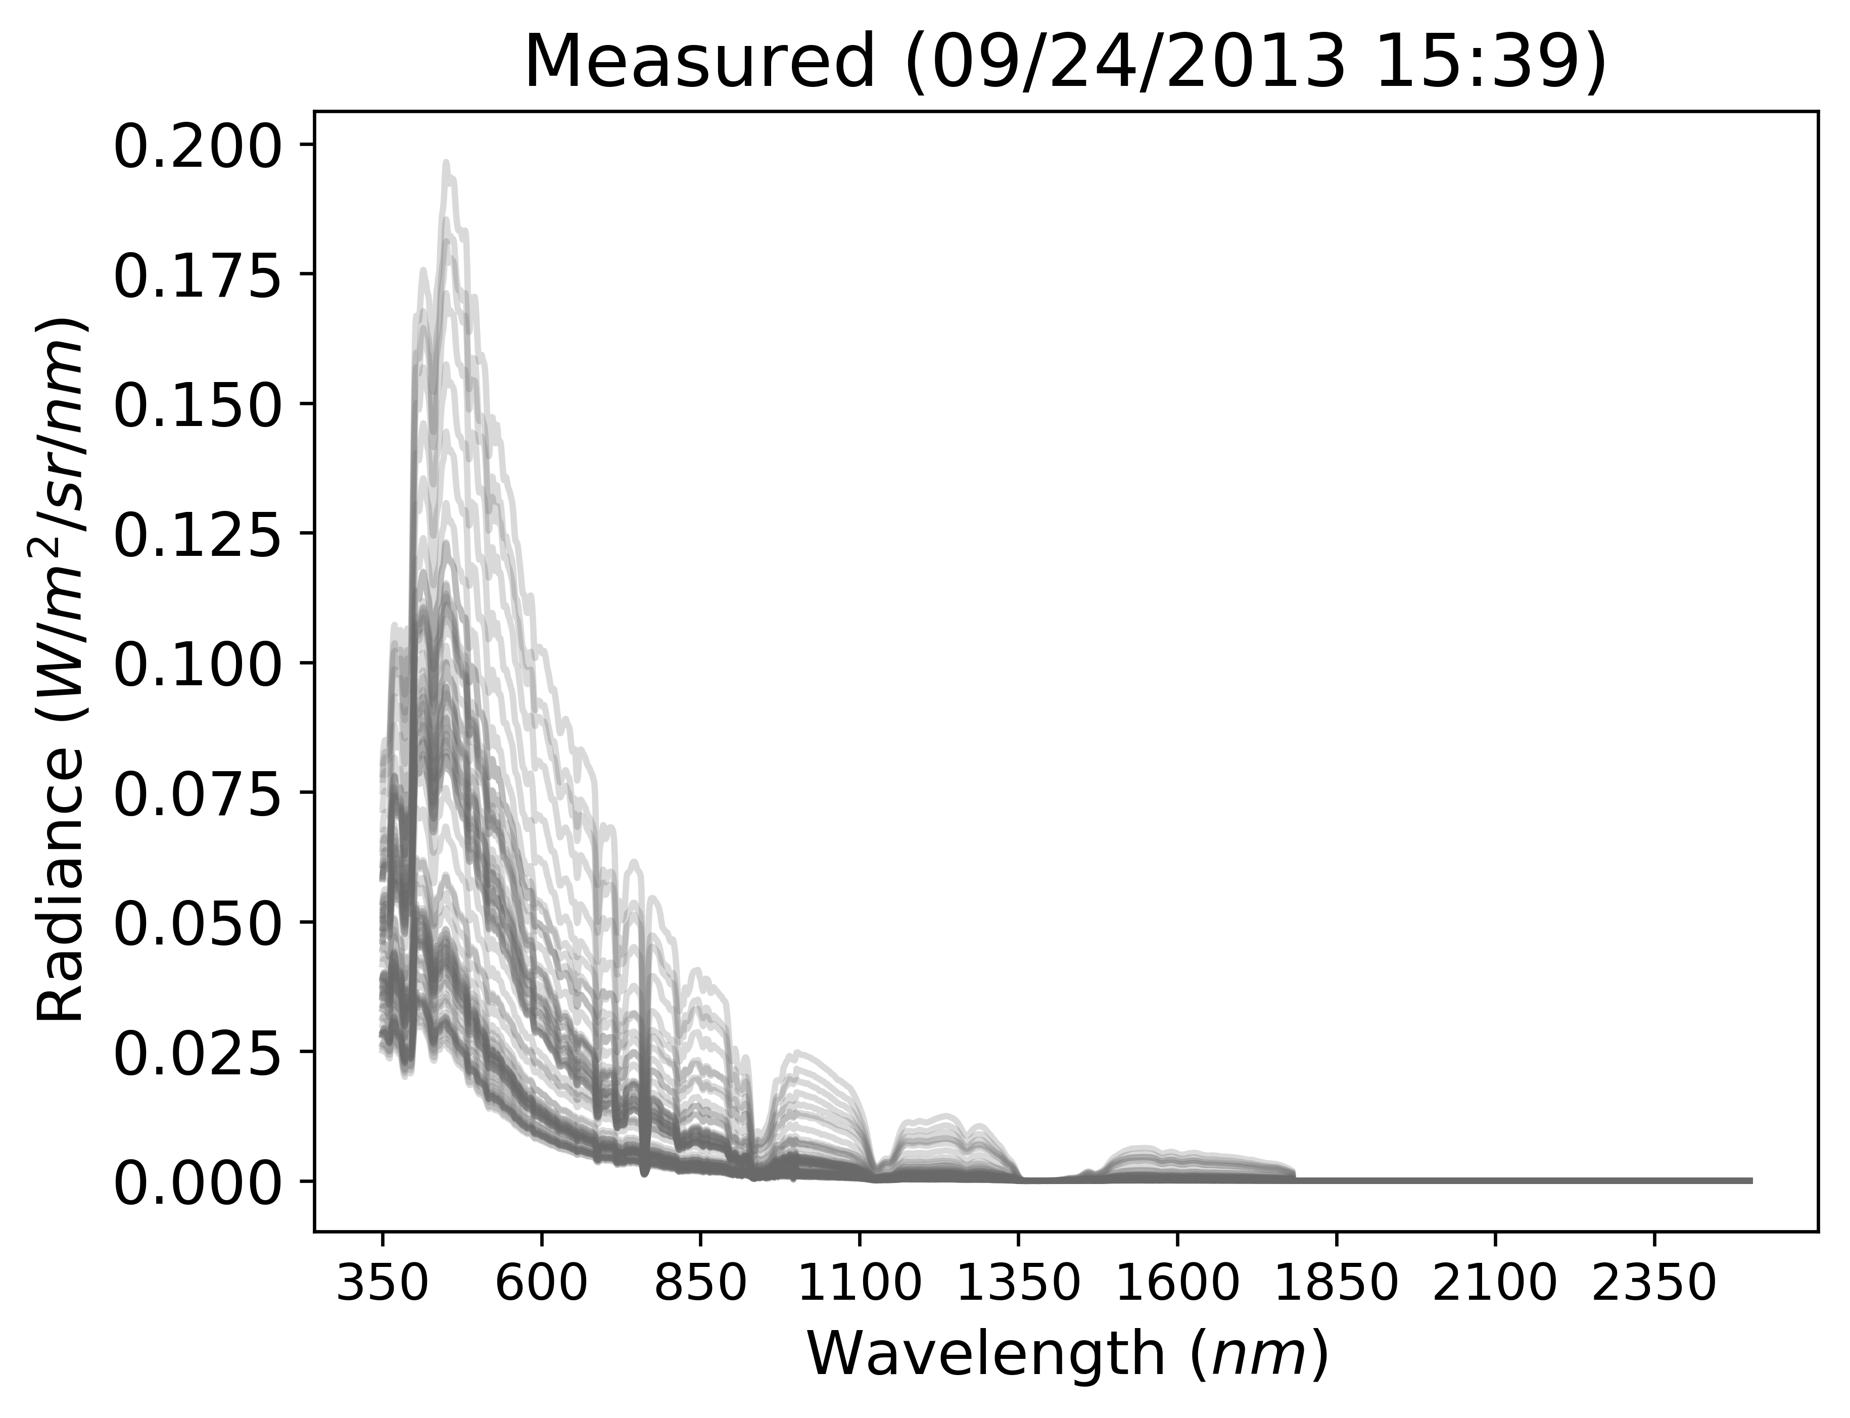
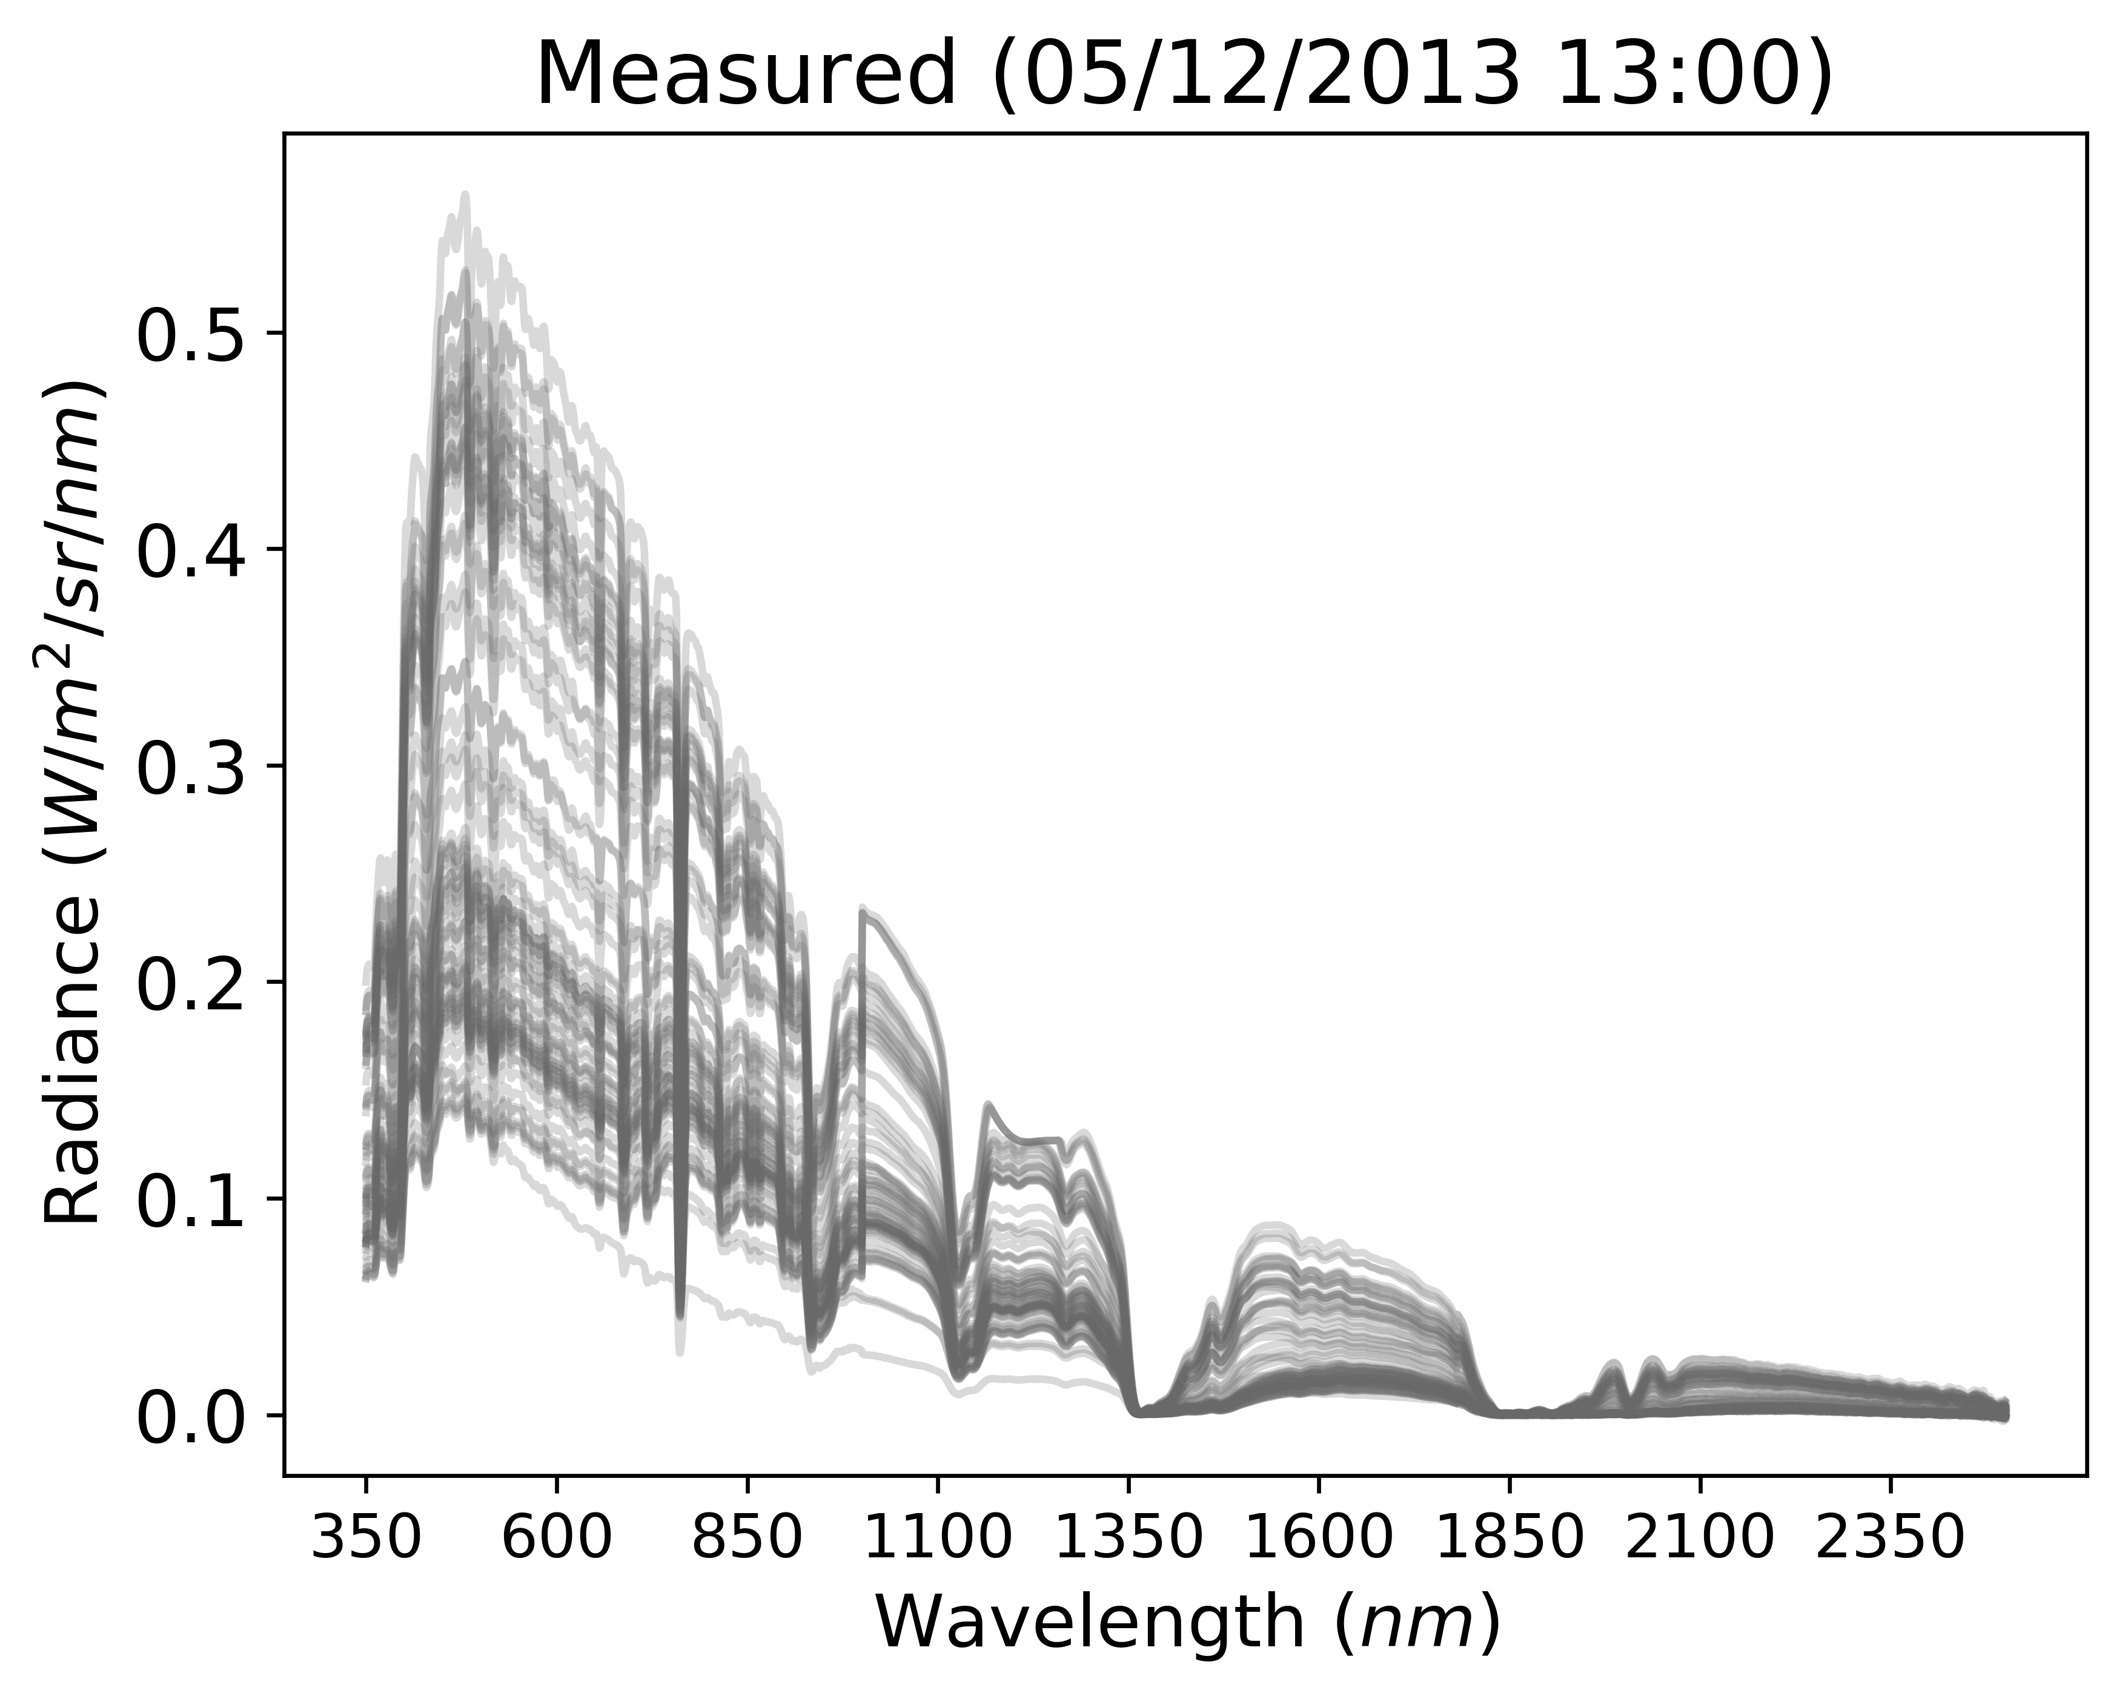
Regression metrics – R²
clear skies more linear in coefficients
scattered skies less linear in coefficients

Slide 14
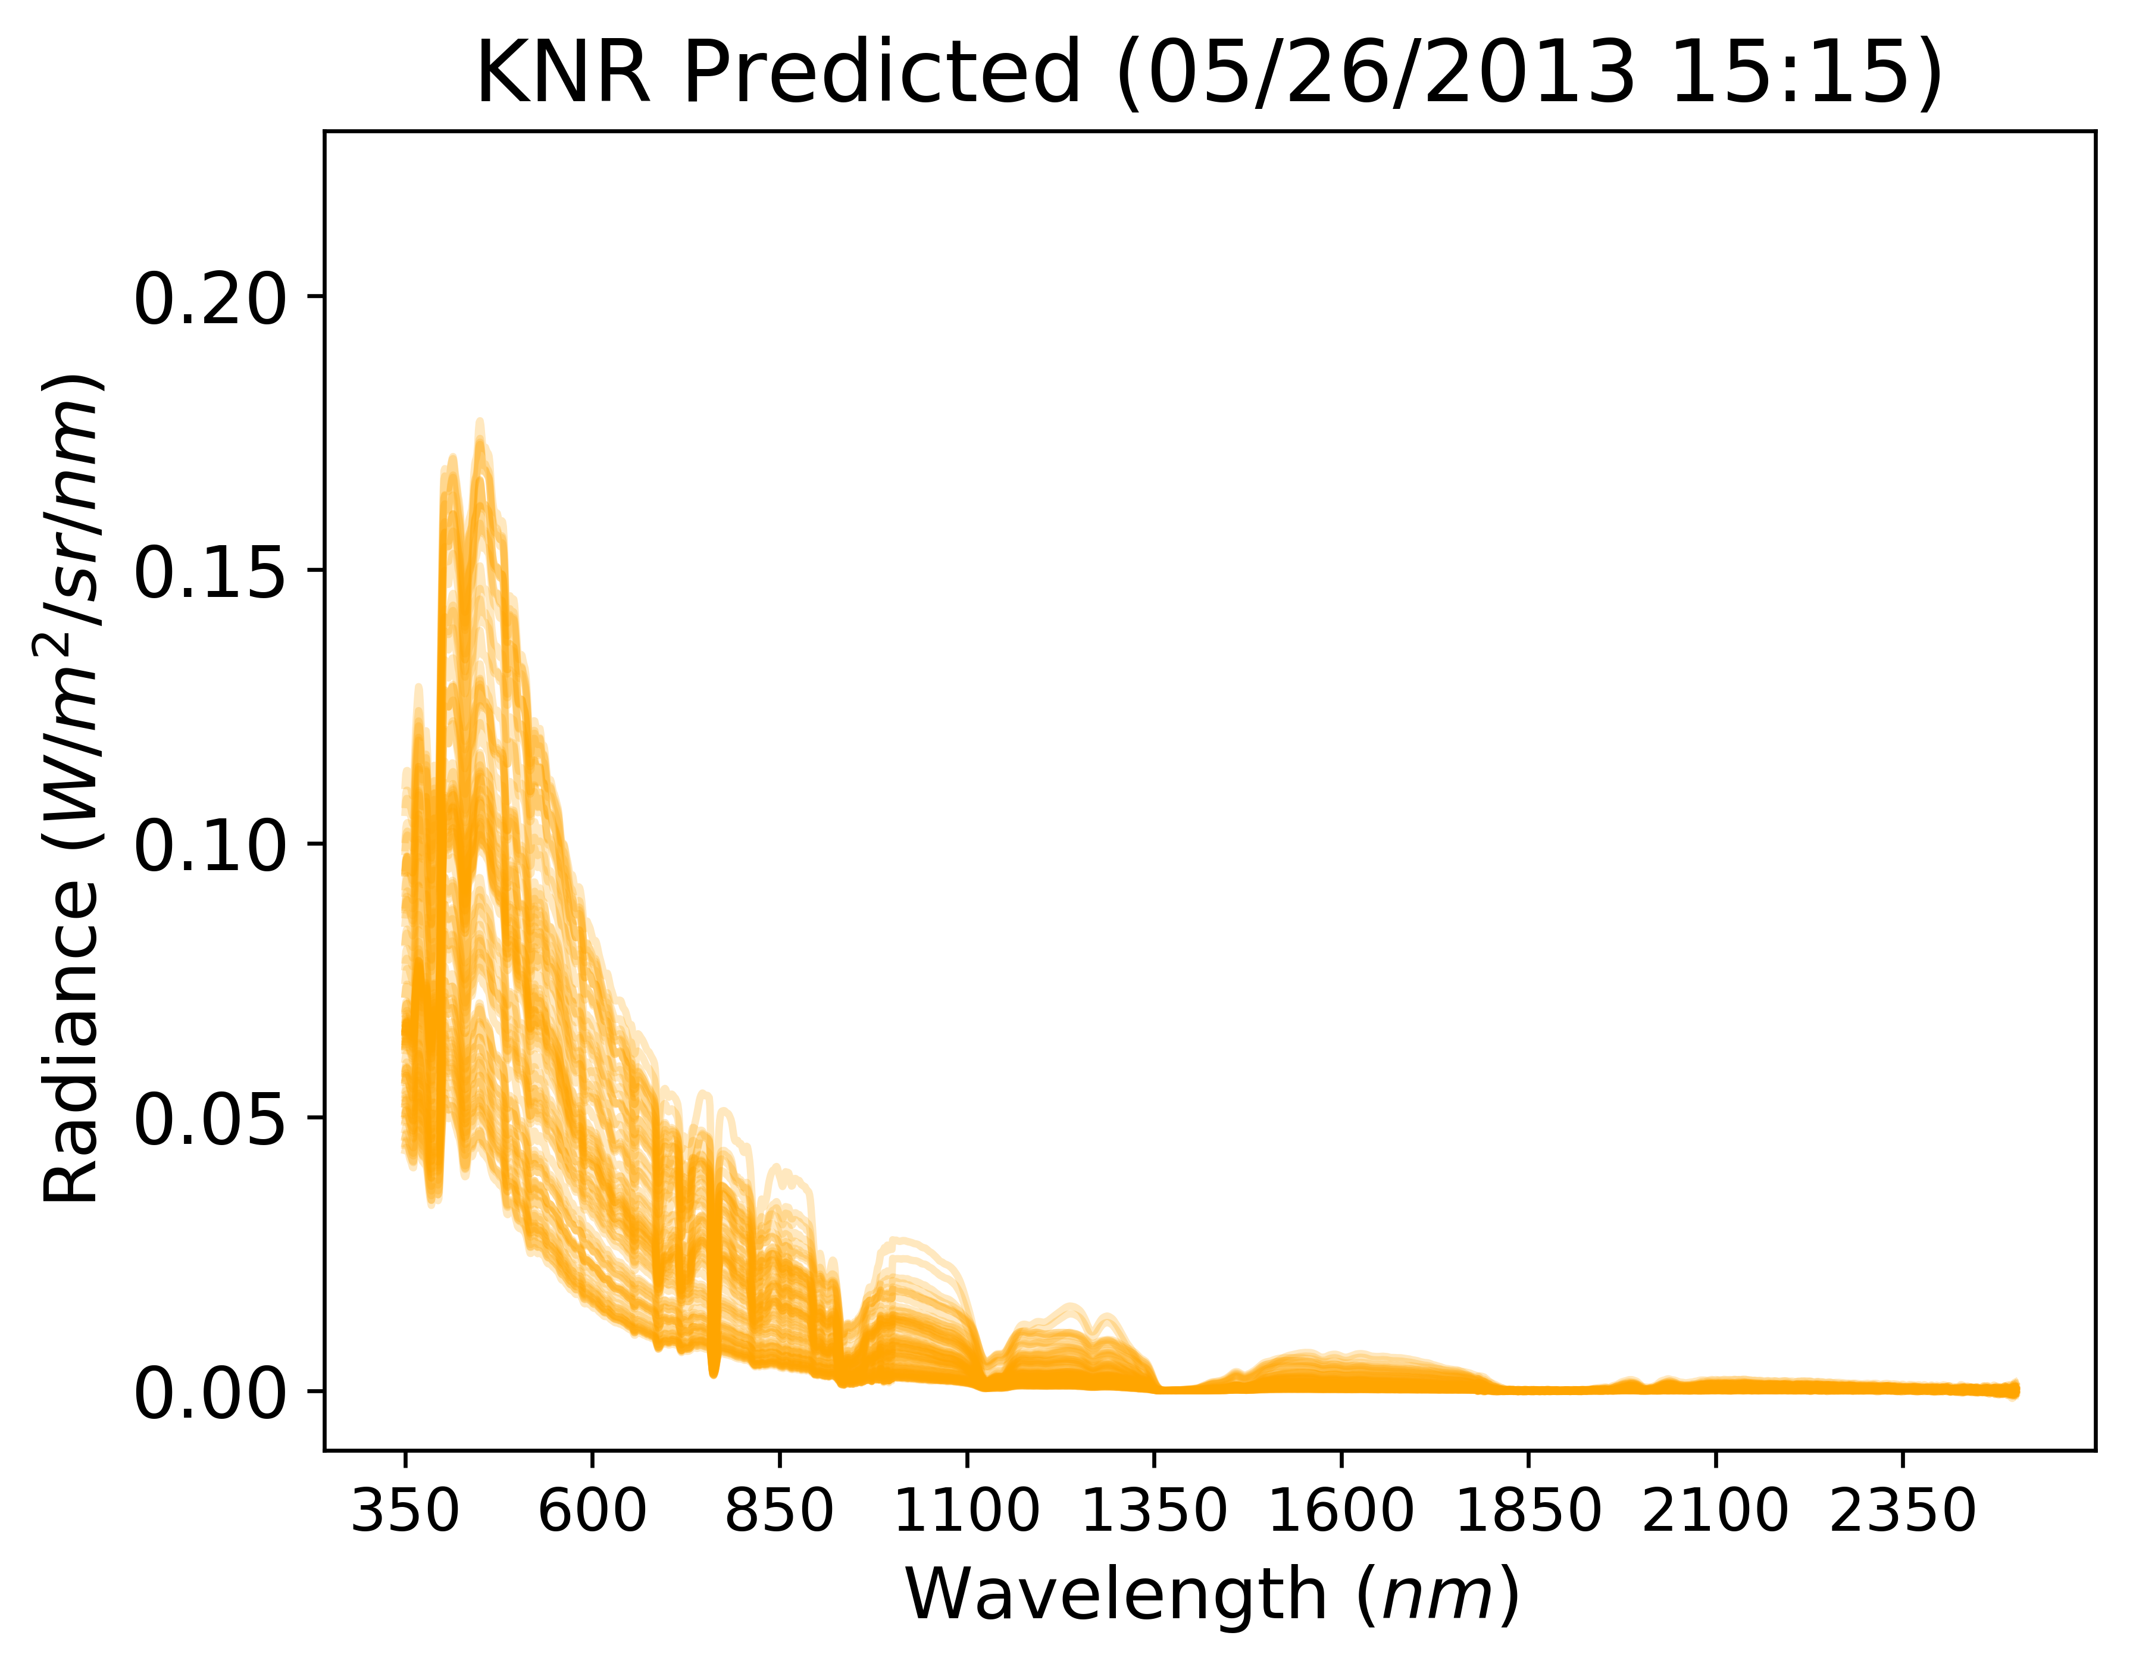
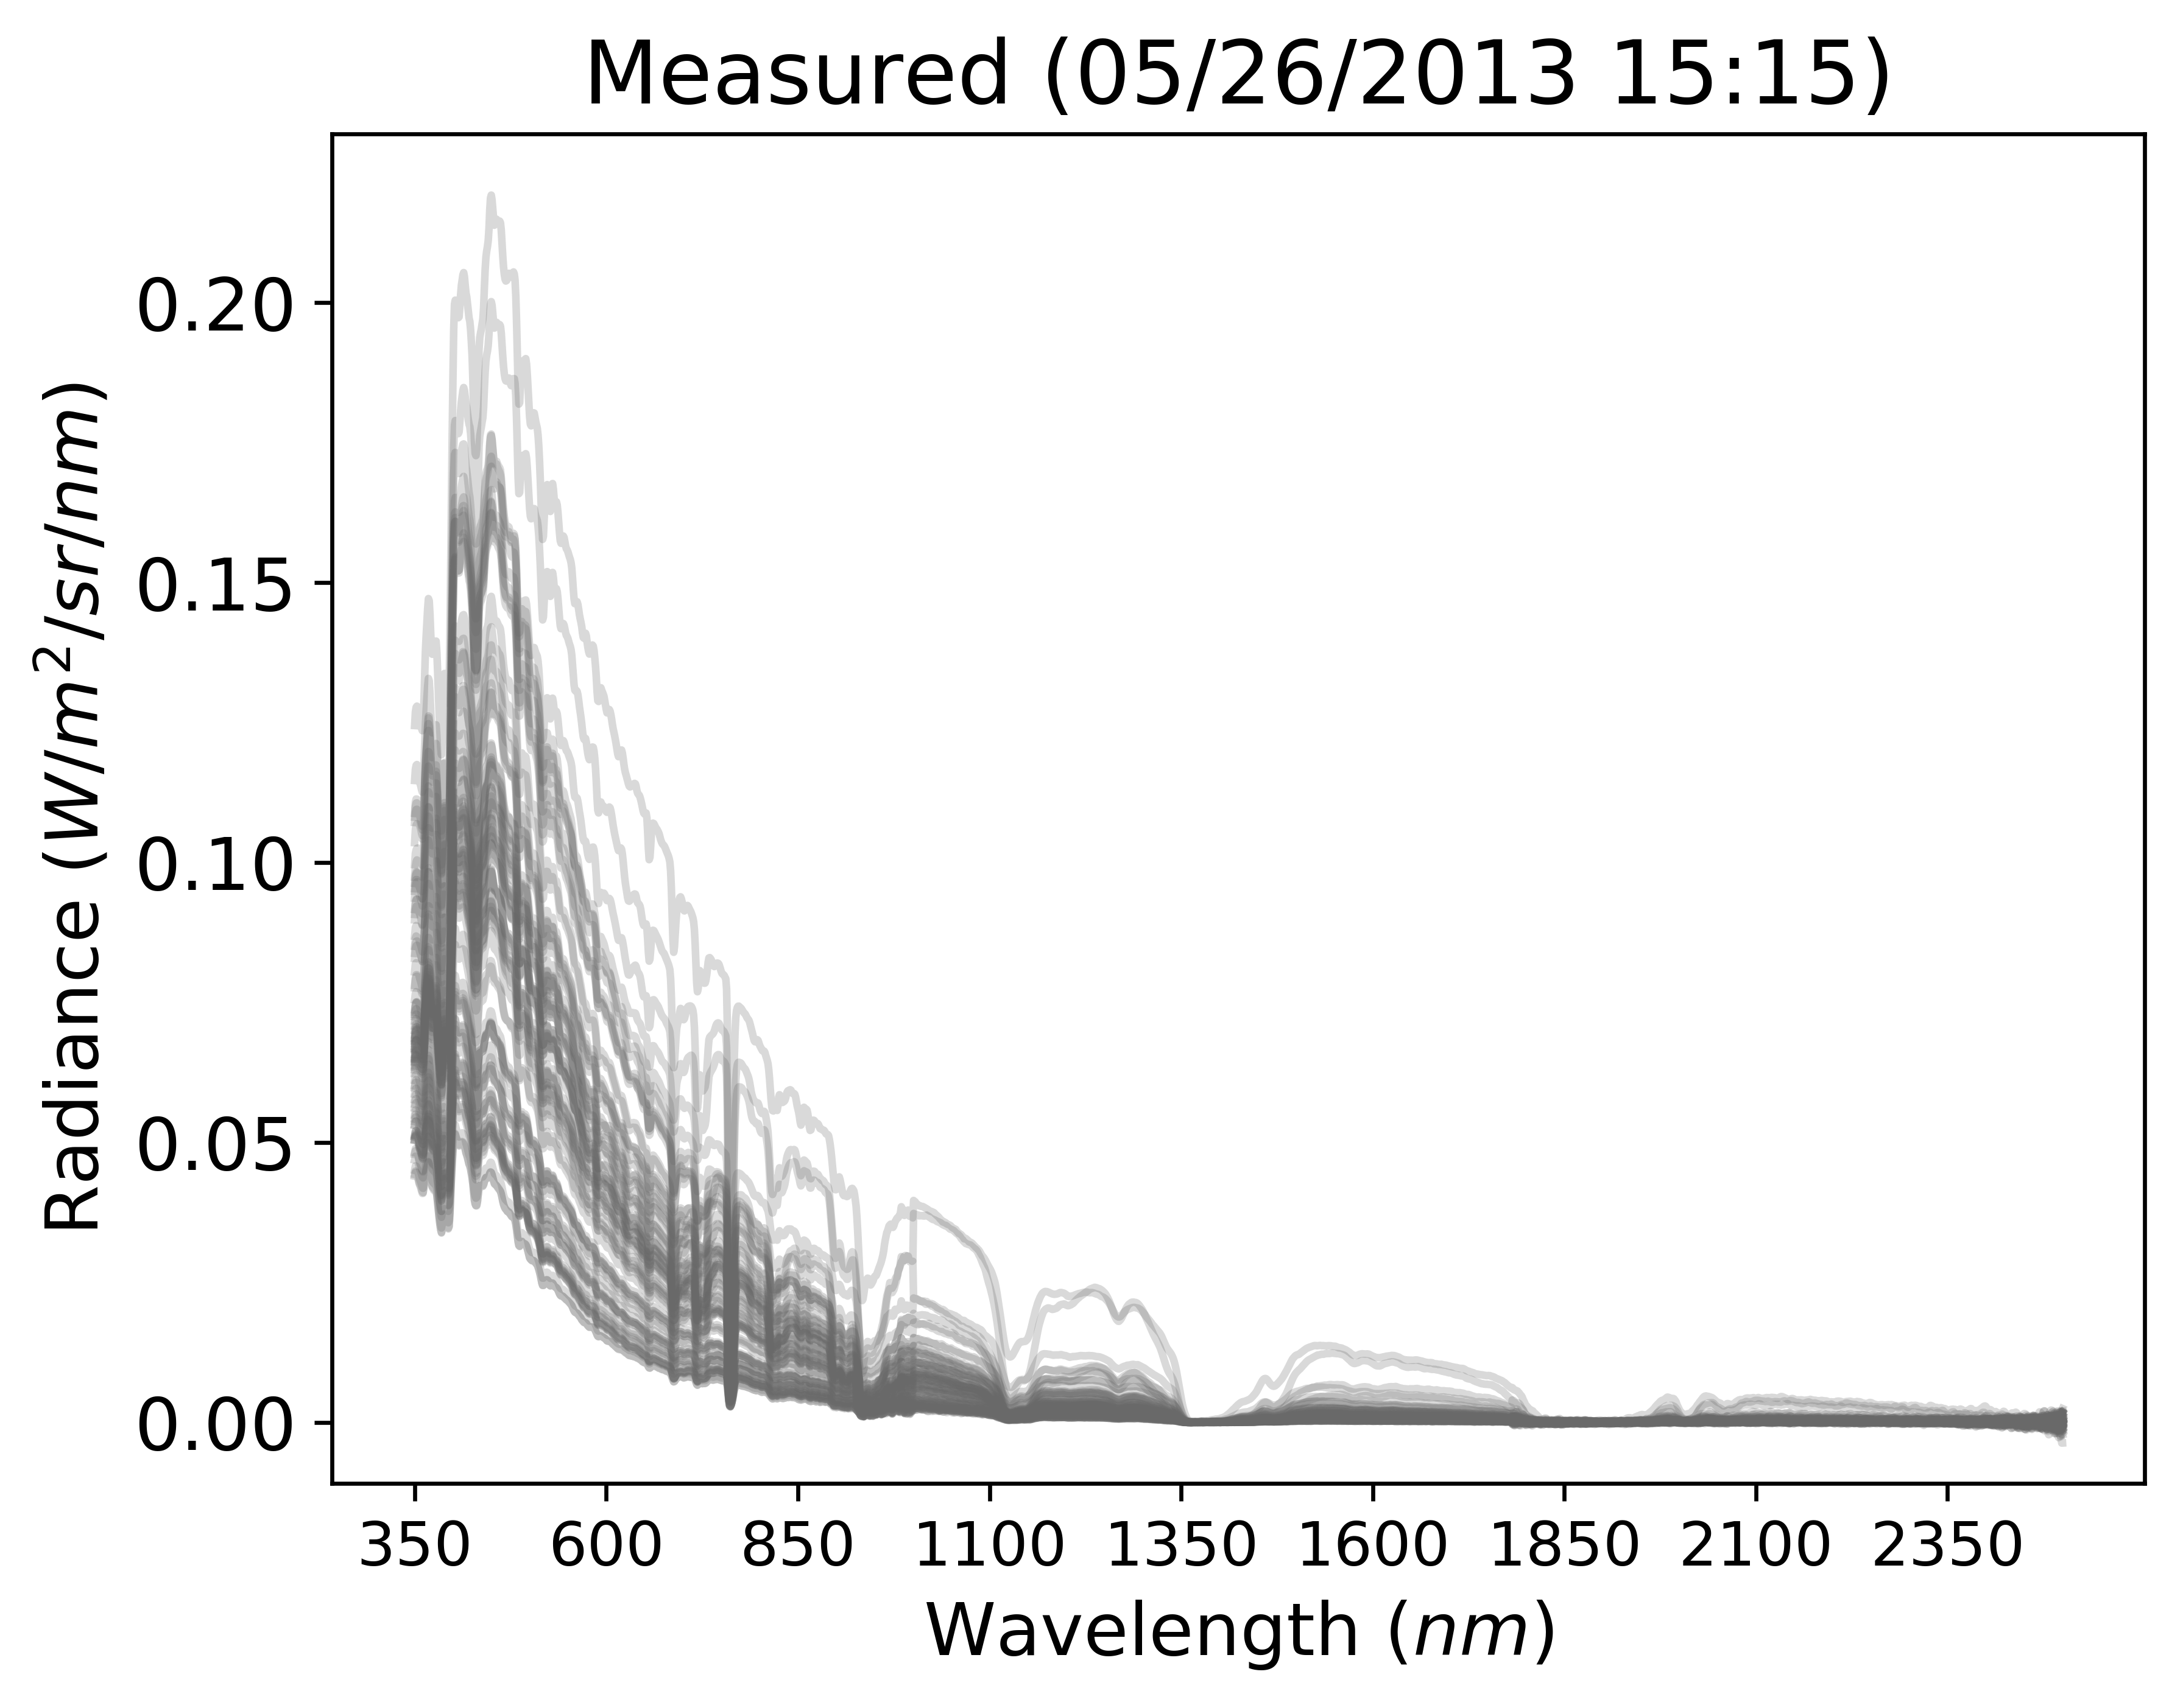
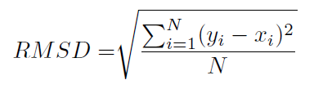
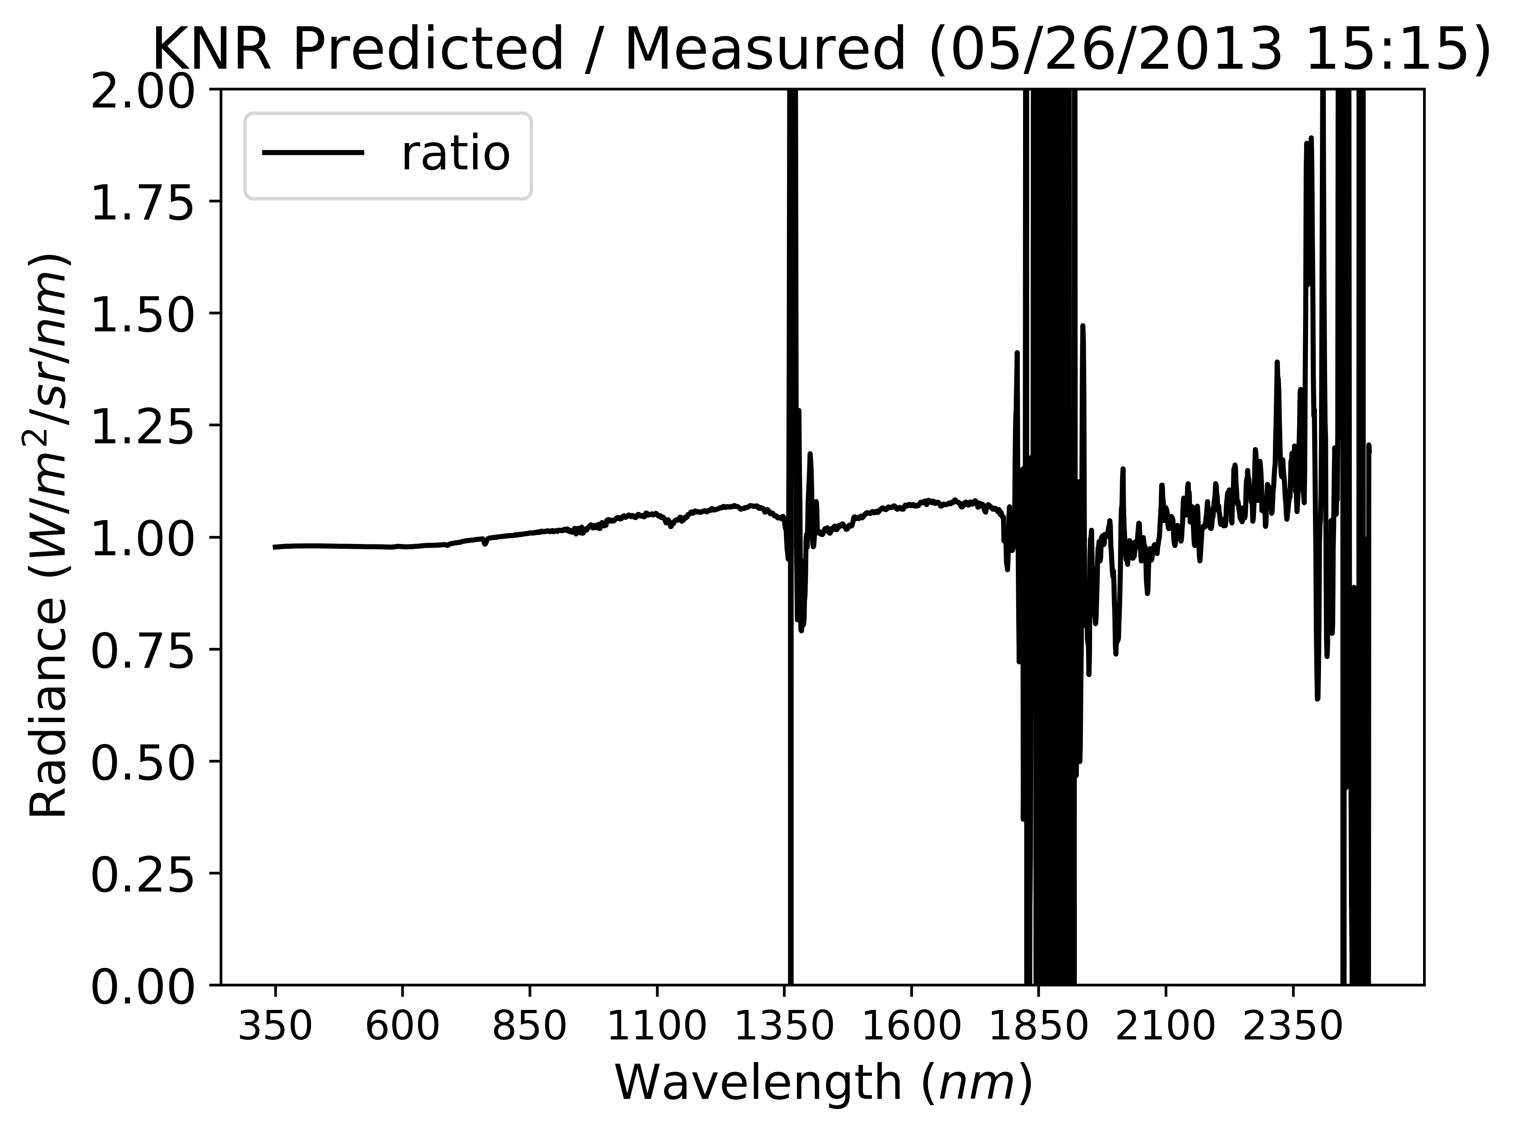
Regression metrics – standard
RMSD – root mean squared (weight points further from mean)
MBD – mean bias (positive/negative)
MAD – mean absolute (abs average)
Ratio – actual/predicted (or vice versa)
Notes:
http://statisticsbyjim.com/regression/r-squared-invalid-nonlinear-regression/

Slide 15
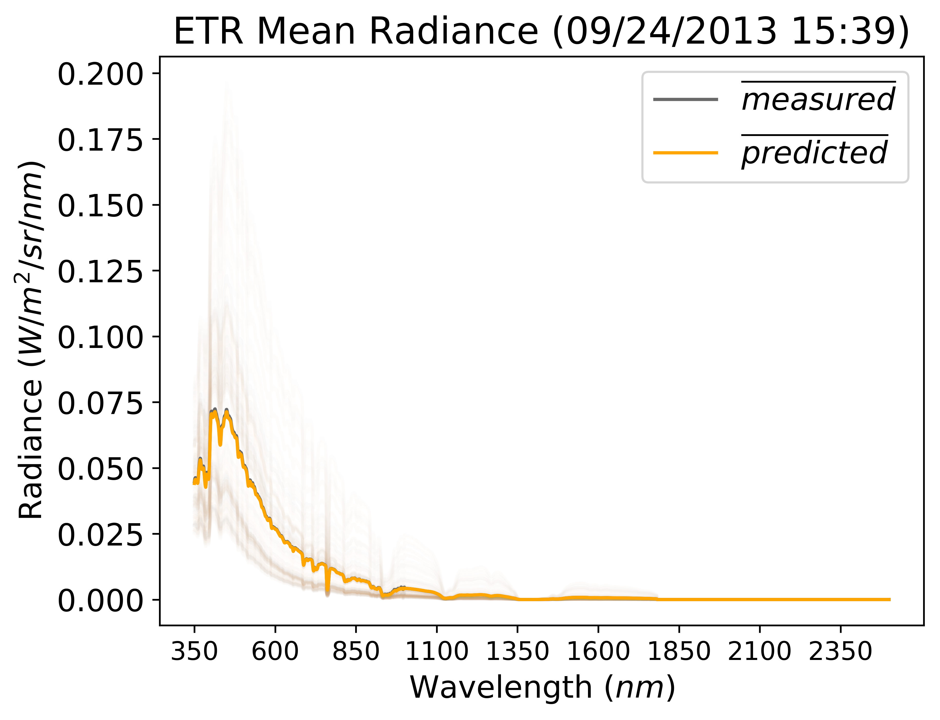
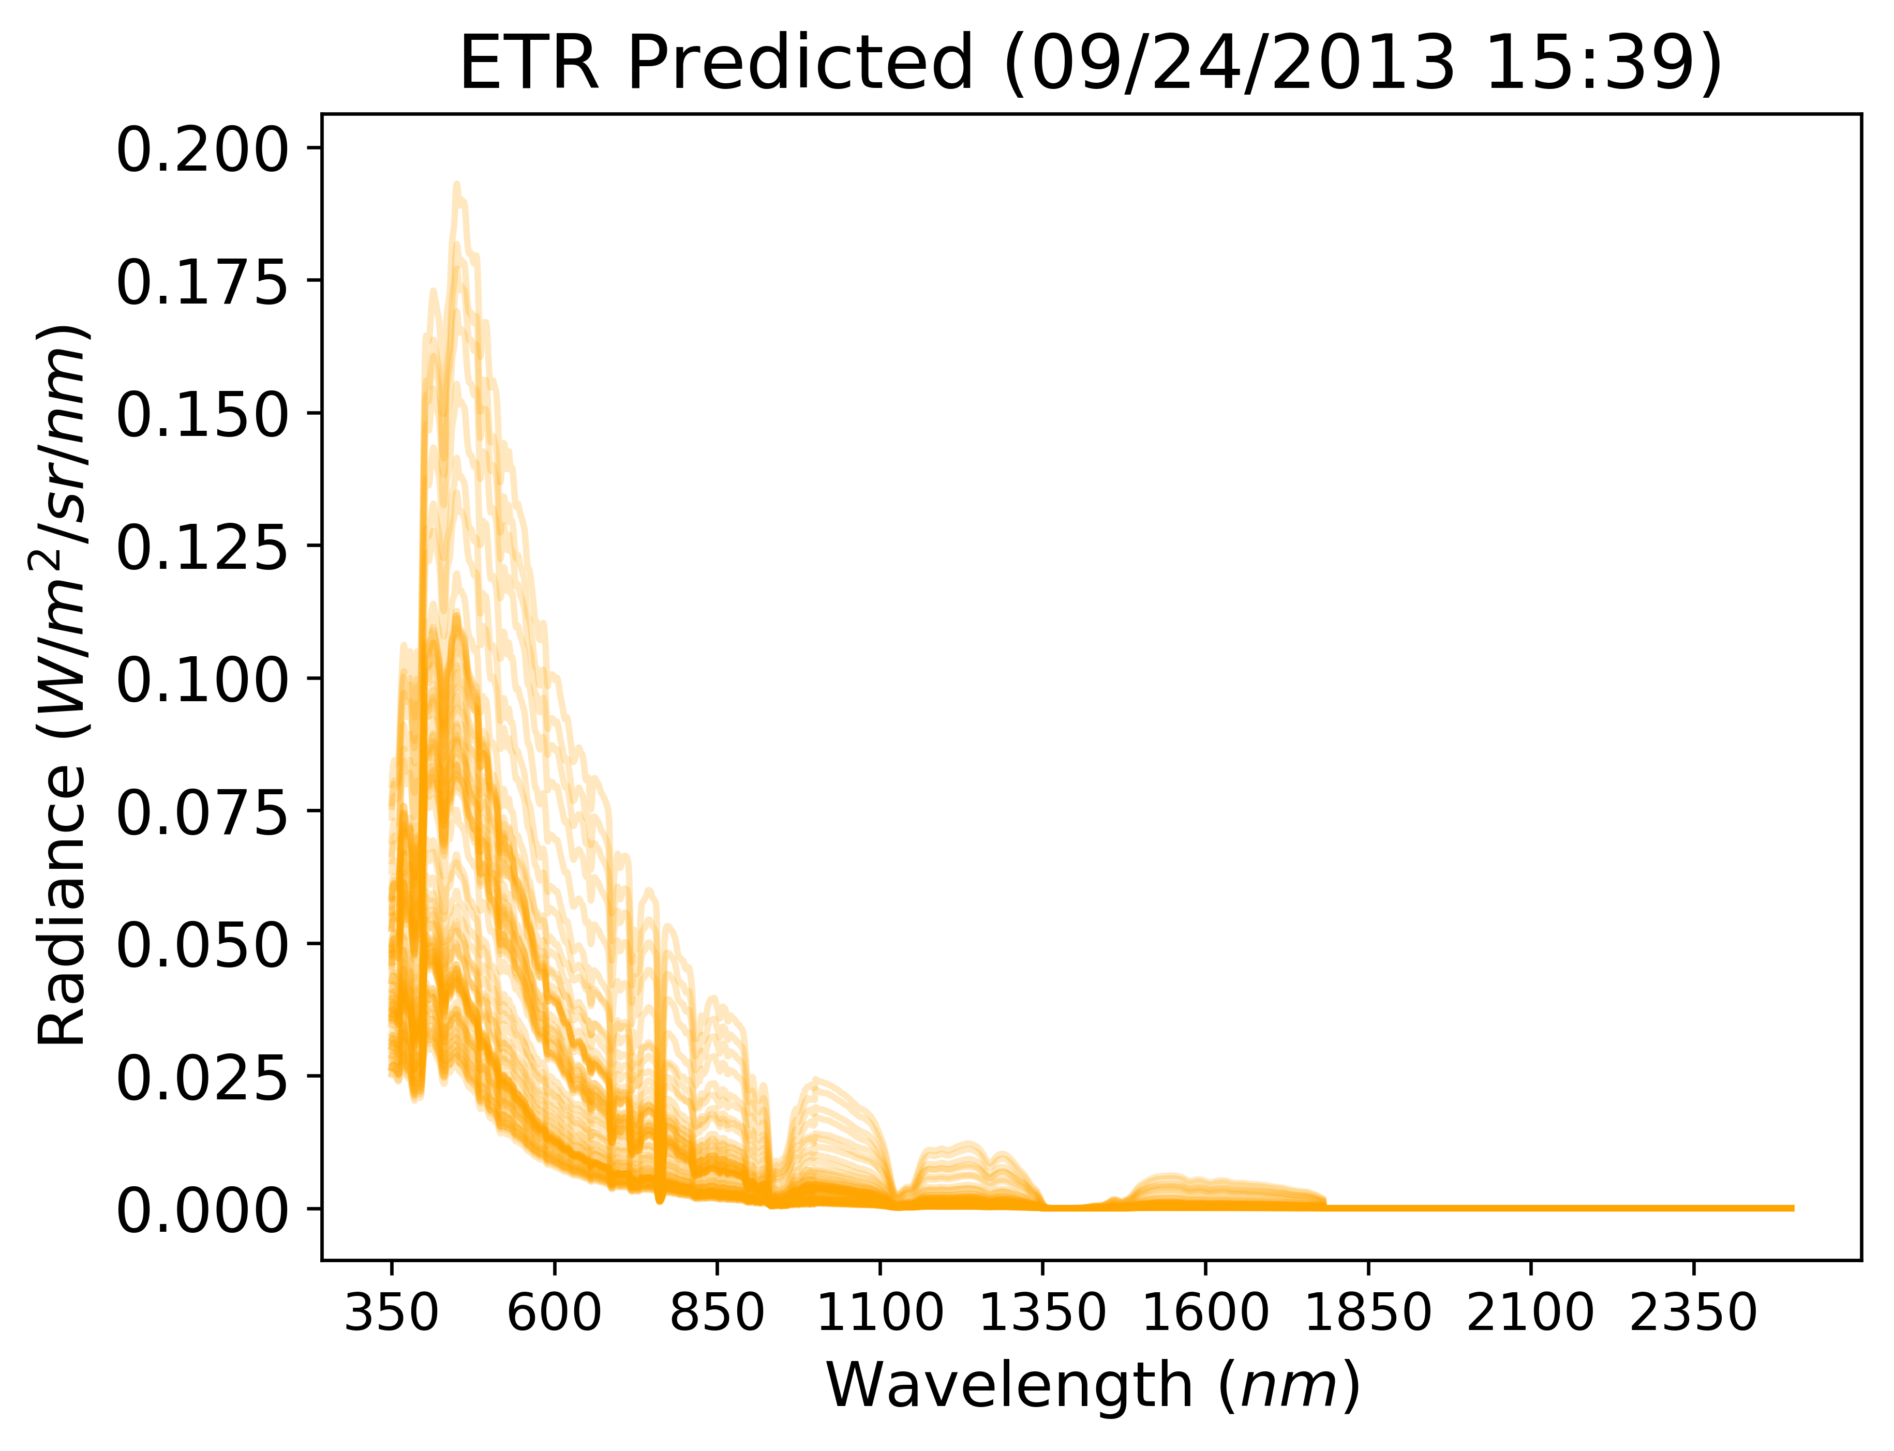
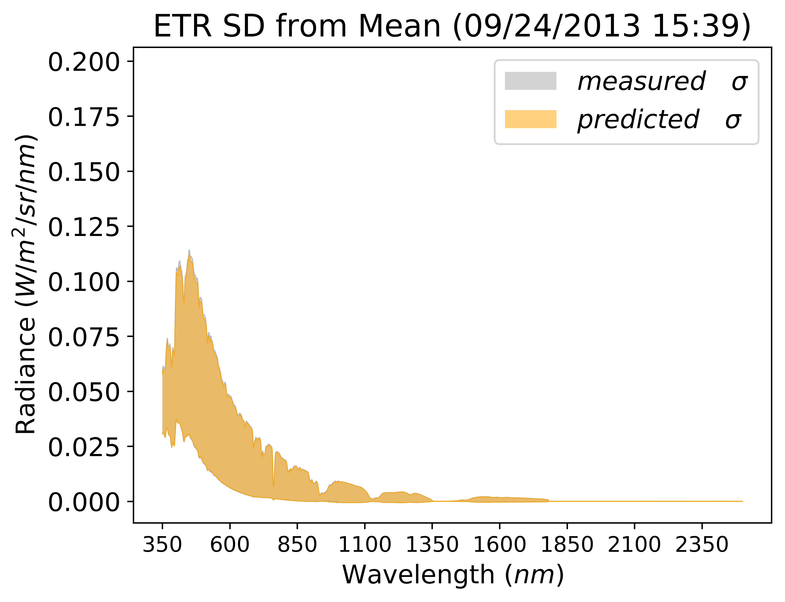
Regression metrics – plotting

Slide 16
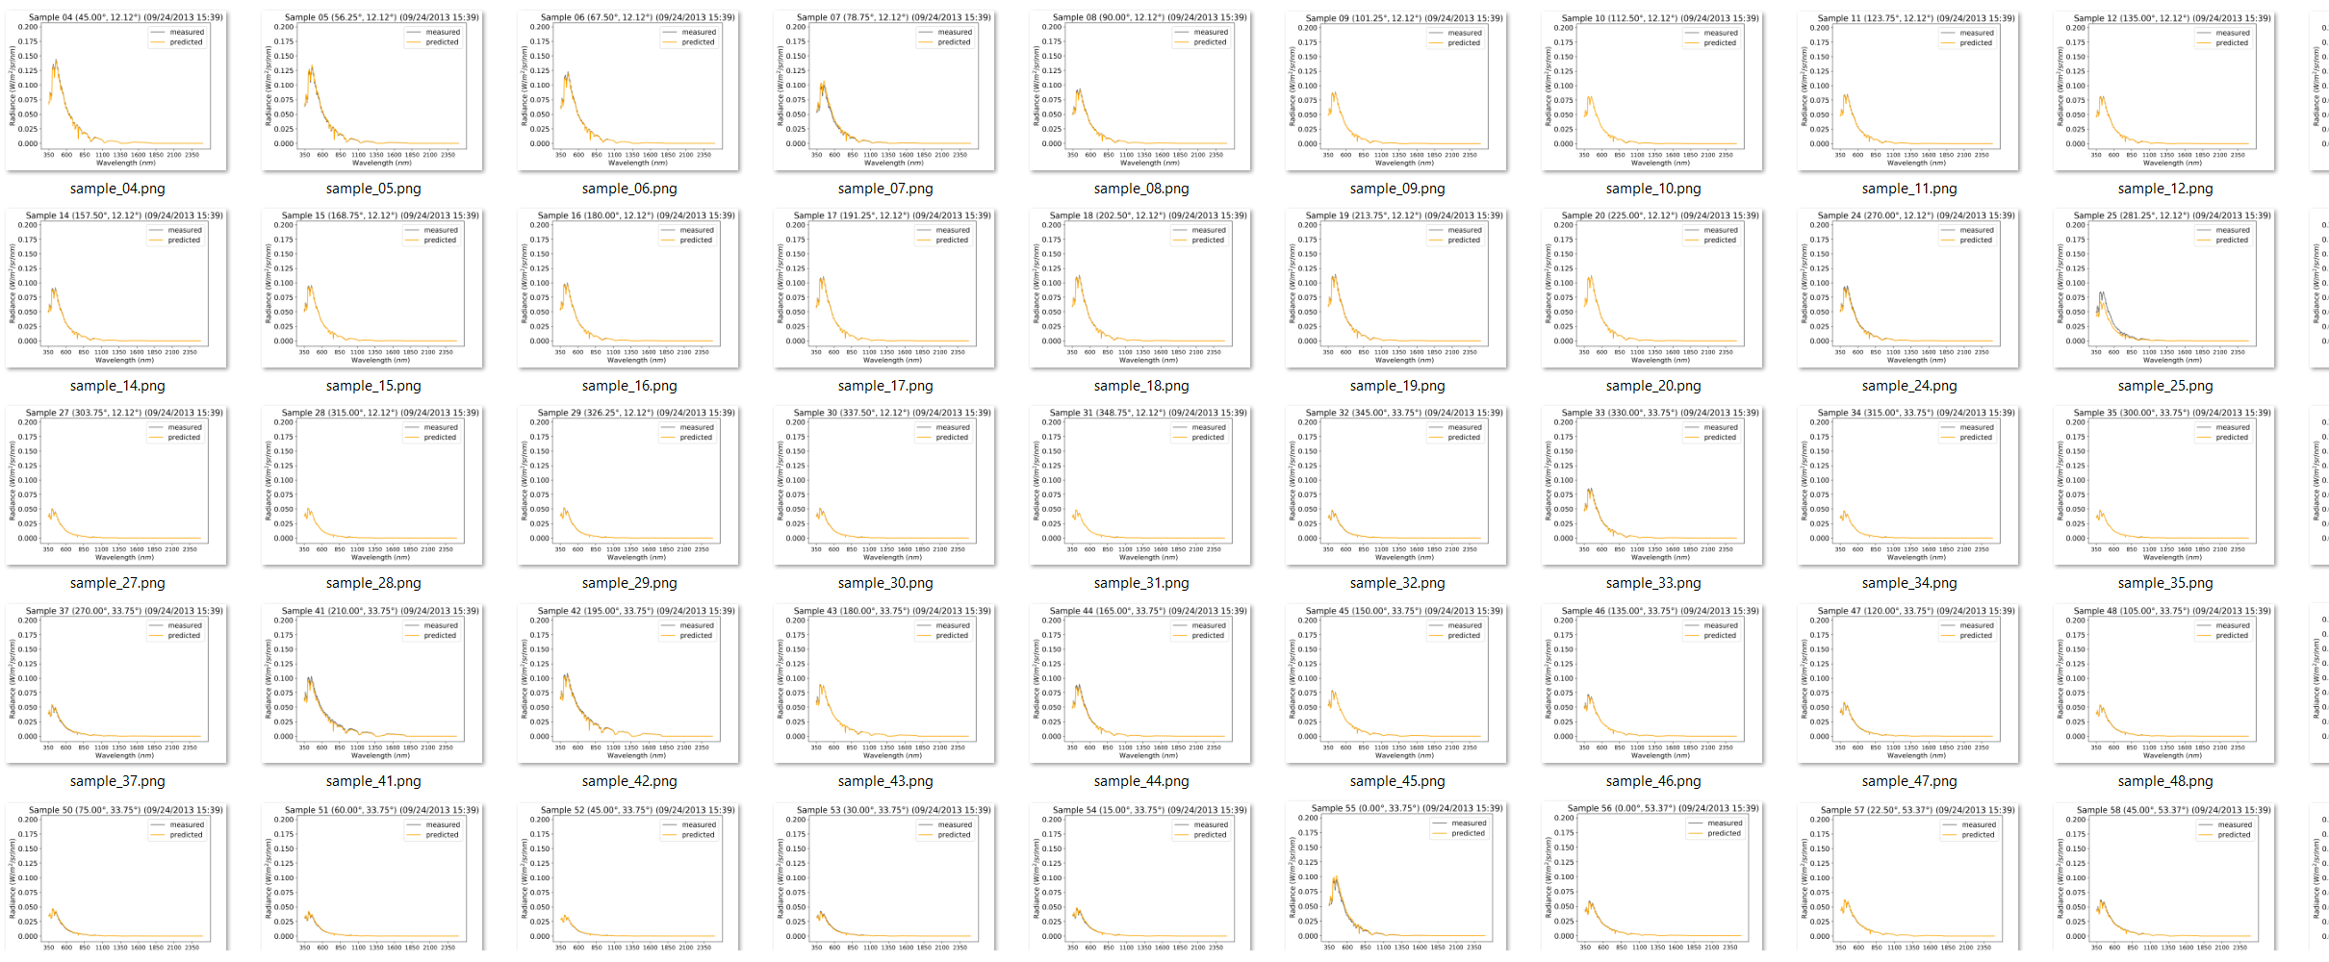
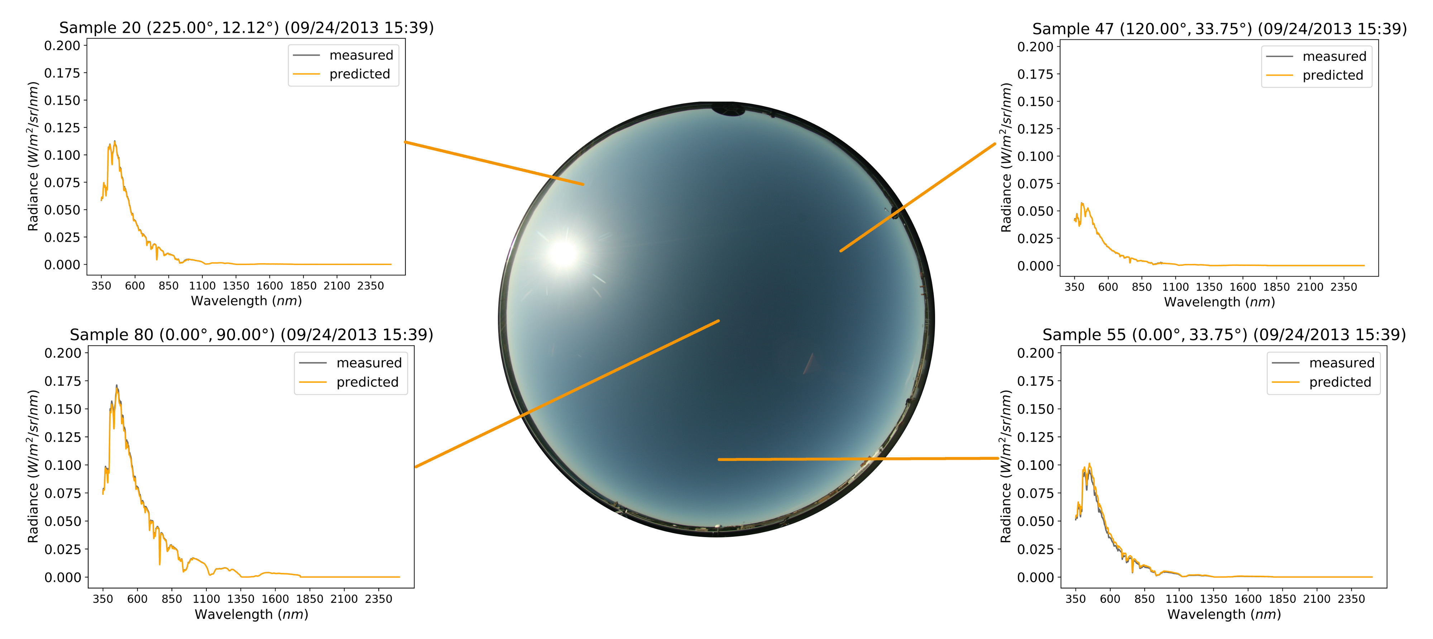
Regression metrics – plotting

Slide 17




Results – models by sky cover

Slide 18
Future / ongoing work
HDR
Color models
GOES satellite data
Additional ML techniques
ANN / deep-learning
MCMC
…
Deploy cyber-physical monitoring system
Validation with other datasets

Slide 19

Questions?
Joseph Del Rocco
jdelrocco@ist.ucf.edu

Slide 20


